Slide 1
What is preposition
Preposition is a word or group of words that is used before a noun or pronoun to show place, time, direction, etc.

Slide 2
“Prepositions of time song”
In the morning, In the afternoon, I think of you always.
In the autumn, summer and in spring, in winter when it’s cold.
In 2016, on the 4th of July, in the future , in the past, even in the 60s too.
In the evening and at night, I’ll say a prayer for you.
At 9 a.m., at midday in March, you’re in my mind.
At sunrise, at sunset, at dinnertime, too.
On weekend in America, on a weekday anywhere
On a holiday, on your birthday, on Monday I’ll miss you.

Slide 3
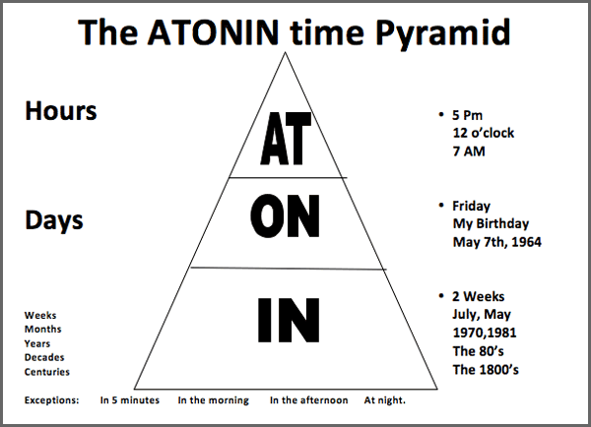
A precise time & specific time
The weekend
Night
Festive periods(Christmas, Easter..etc.)
Special days
Days of the week
Dates
Months
Years
Centuries
Long periods
Seasons

Slide 4
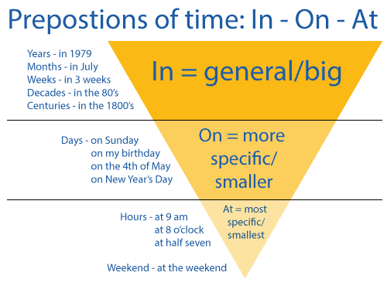
IN + months, years, the morning/afternoon/evening | in March, in the morning
ON + days, dates | on Monday, on 16th January
AT + time(hours and minutes) of day, noon/ night | at four o’clock, at night

Slide 6
Ticktacktoe game
At/ In/ On
Dianne& Rachel

Slide 7
#1
The company started on 1989.
The company started at 1989.
The company started in 1989.
At/ In/ On

Slide 8
I like to get up early on the morning.
I like to get up early in the morning.
I like to get up early at the morning.
#2
I always feel tired in the evening.
I always feel tired on the evening.
I always feel tired at the evening.
At/ In/ On

Slide 9
#3
We don’t often go out in night.
We don’t often go out at night.
We don’t often go out on night.
At/ In/ On

Slide 10
#4
My brother got married in May.
My brother got married at May.
My brother got married on May.
At/ In/ On

Slide 11
#5
The concert is at November 20.
The concert is in November 20.
The concert is on November 20.
At/ In/ On

Slide 12
#6
Laura finished high school at 2002.
Laura finished high school in 2002.
Laura finished high school on 2002.
At/ In/ On

Slide 13
#7
The park is beautiful in the fall.
The park is beautiful on the fall.
The park is beautiful at the fall.
At/ In/ On

Slide 14
#8
What are you going to do on Christmas?
What are you going to do in Christmas?
What are you going to do at Christmas?
At/ In/ On

Slide 15
#9
It closes at midnight.
It closes on midnight.
It closes in midnight.
At/ In/ On

Slide 16
#10
We often go to the beach in the summer.
We often go to the beach on the summer.
We often go to the beach at summer.
At/ In/ On

Slide 17
#11
Tim was born in 1997.
Tim was born on 1997.
Tim was born at 1997.
At/ In/ On

Slide 18
#12
I can’t meet you on Friday.
I can’t meet you in Friday.
I can’t meet you at Friday.
At/ In/ On

Slide 19
#13
I got up at 8:00 o’clock this morning.
I got up in 8:00 o’clock this morning.
I got up on 8:00 o’clock this morning.
At/ In/ On

Slide 20
#14
I like to get up early on the morning.
I like to get up early in the morning.
I like to get up early at the morning.
At/ In/ On

Slide 21
#15
I’m taking a trip in October.
I’m taking a trip on October.
I’m taking a trip at October.
At/ In/ On

Slide 22
Answer
sheet
The company started in 1989.
I always feel tired in the evening.
We don’t often go out at night.
My brother got married in May.
The concert is on November 20.
Laura finished high school in 2002.
The park is beautiful in the fall.
What are you going to do on Christmas?
It closes at midnight.
We often go to the beach in the summer.
Tim was born in 1997.
I can’t meet you on Friday.
I got up at 8:00 o’clock this morning.
I like to get up early in the morning.
I’m taking a trip in October.
At/ In/ On

Slide 23
X

Slide 24
O

Slide 25
Thursday
night
8:00
the winter

Slide 26
7:30
the morning
February
1997

Slide 27
2 o’ clock
May
afternoon
New Year’s Eve

Slide 28
sunset
spring
afternoon
Monday

Slide 29
my birthday
June
Saturday
the summer

Slide 30
my birthday
noon
Friday night
11:45

Slide 31
2016
fall
Christmas eve
midnight

Slide 32
The evening
Sunday
July
2007

Slide 33
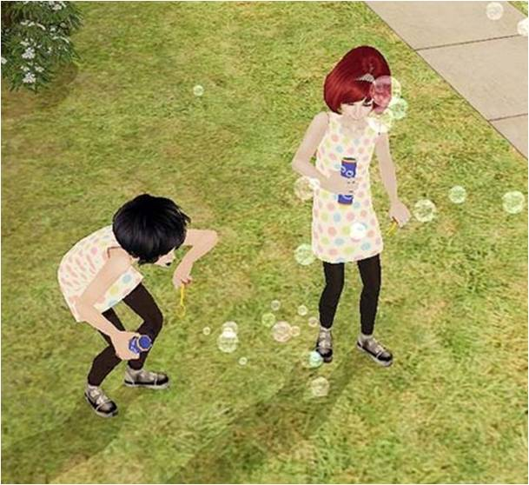
THANK YOU

Slide 34
RAP of time prepositions
In
In August I feel fine, In November you were mine.
In 1995 I had a job, in 1998 I had none.
In winter I miss the sun.
In the morning, I start my day.
In the afternoon, I go away.
In the evening you come to me.
In a minute you will see
In two weeks you’ll be with me.
On
On Sunday, there will be dinner.
On Friday, I will be the winner.
On the 25th of December, On Easter Sunday and on my birthday,
there will be a great big party.
On the morning of March the 1st , my aircraft is going to rise into heaven.
At
At night I sleep.
At 6’o clock I go to work.
At midnight I still watch TV.
At Christmas, I will be at home.
At Easter, I will be alone.
At the same time every day all my neighbors go away.

