Slide 1
https://www.youtube.com/watch?v=qlPx6tmAIlM

Slide 2
How are you feeling today?

Slide 3
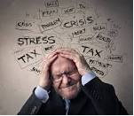
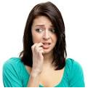

Slide 4
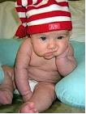
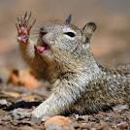

Slide 5
Worries that never happen in real life
4%
4%
Worries that have already happened
40%
22%
Worries that are unimportant
30%
Worries that are things we have no power to fix
Worries that are things we have the power to fix

Slide 6
40% of the things we worry about never happen in real life.
30% of the things we worry about have already happened.
22% of the things we worry about are trifling and unimportant.
4% of the things we worry about are things we have no power to fix.
4% of the things we worry about are things we have the power to fix.
- Ernie J. Zelinski excerpt from "The Joy of Not Knowing It All"

Slide 7
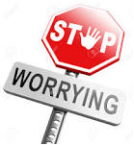
How to stop worrying about stuff

Slide 9
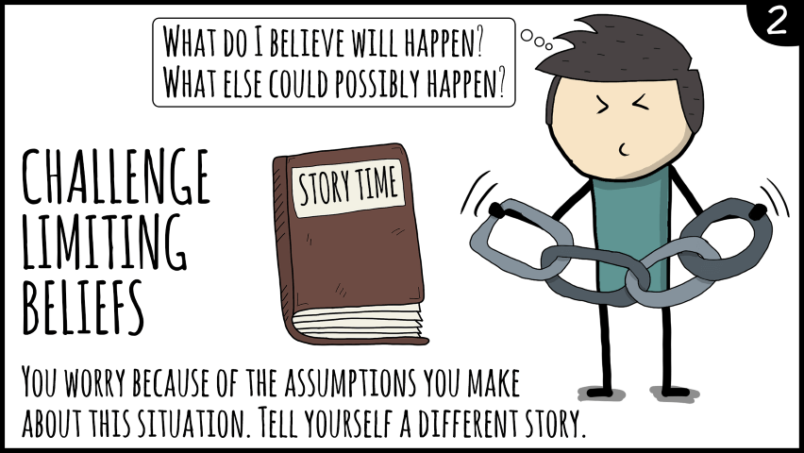

Slide 10
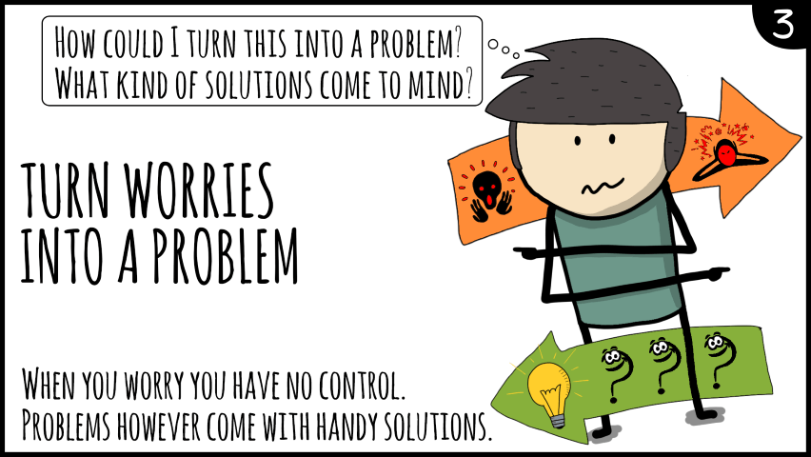

Slide 11
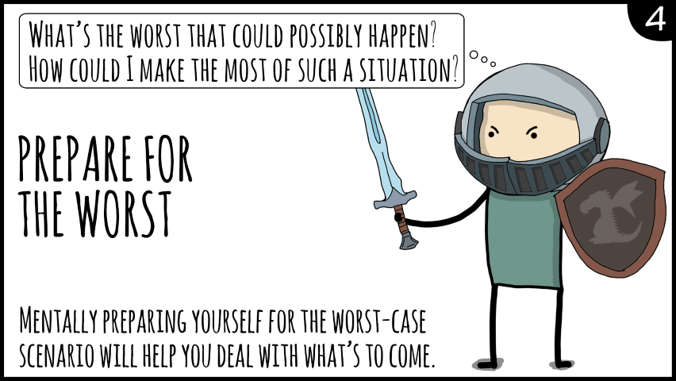

Slide 12
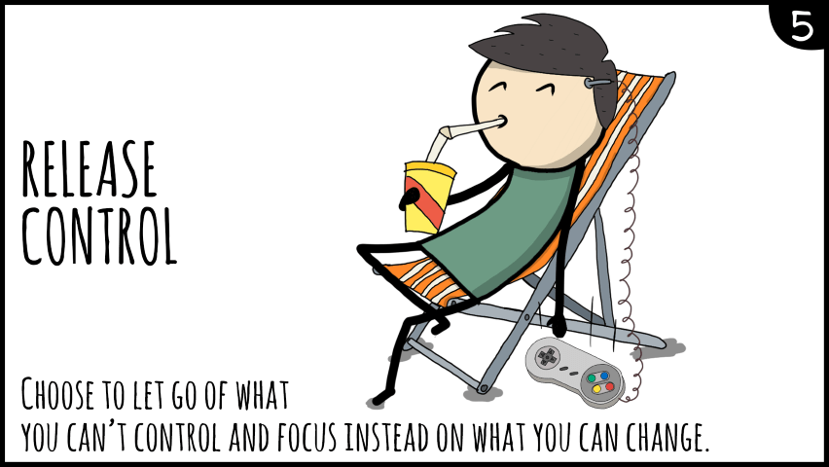

Slide 13
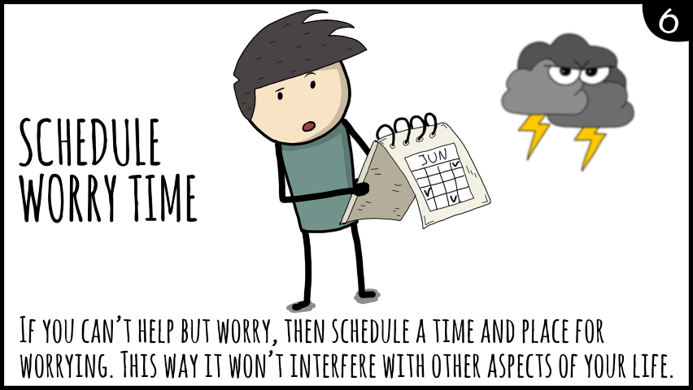

Slide 14
New Top 5 Vocabularies
worrier
trifling ( verb : trifle)
perspective
manifestation
predicament

