Slide 1
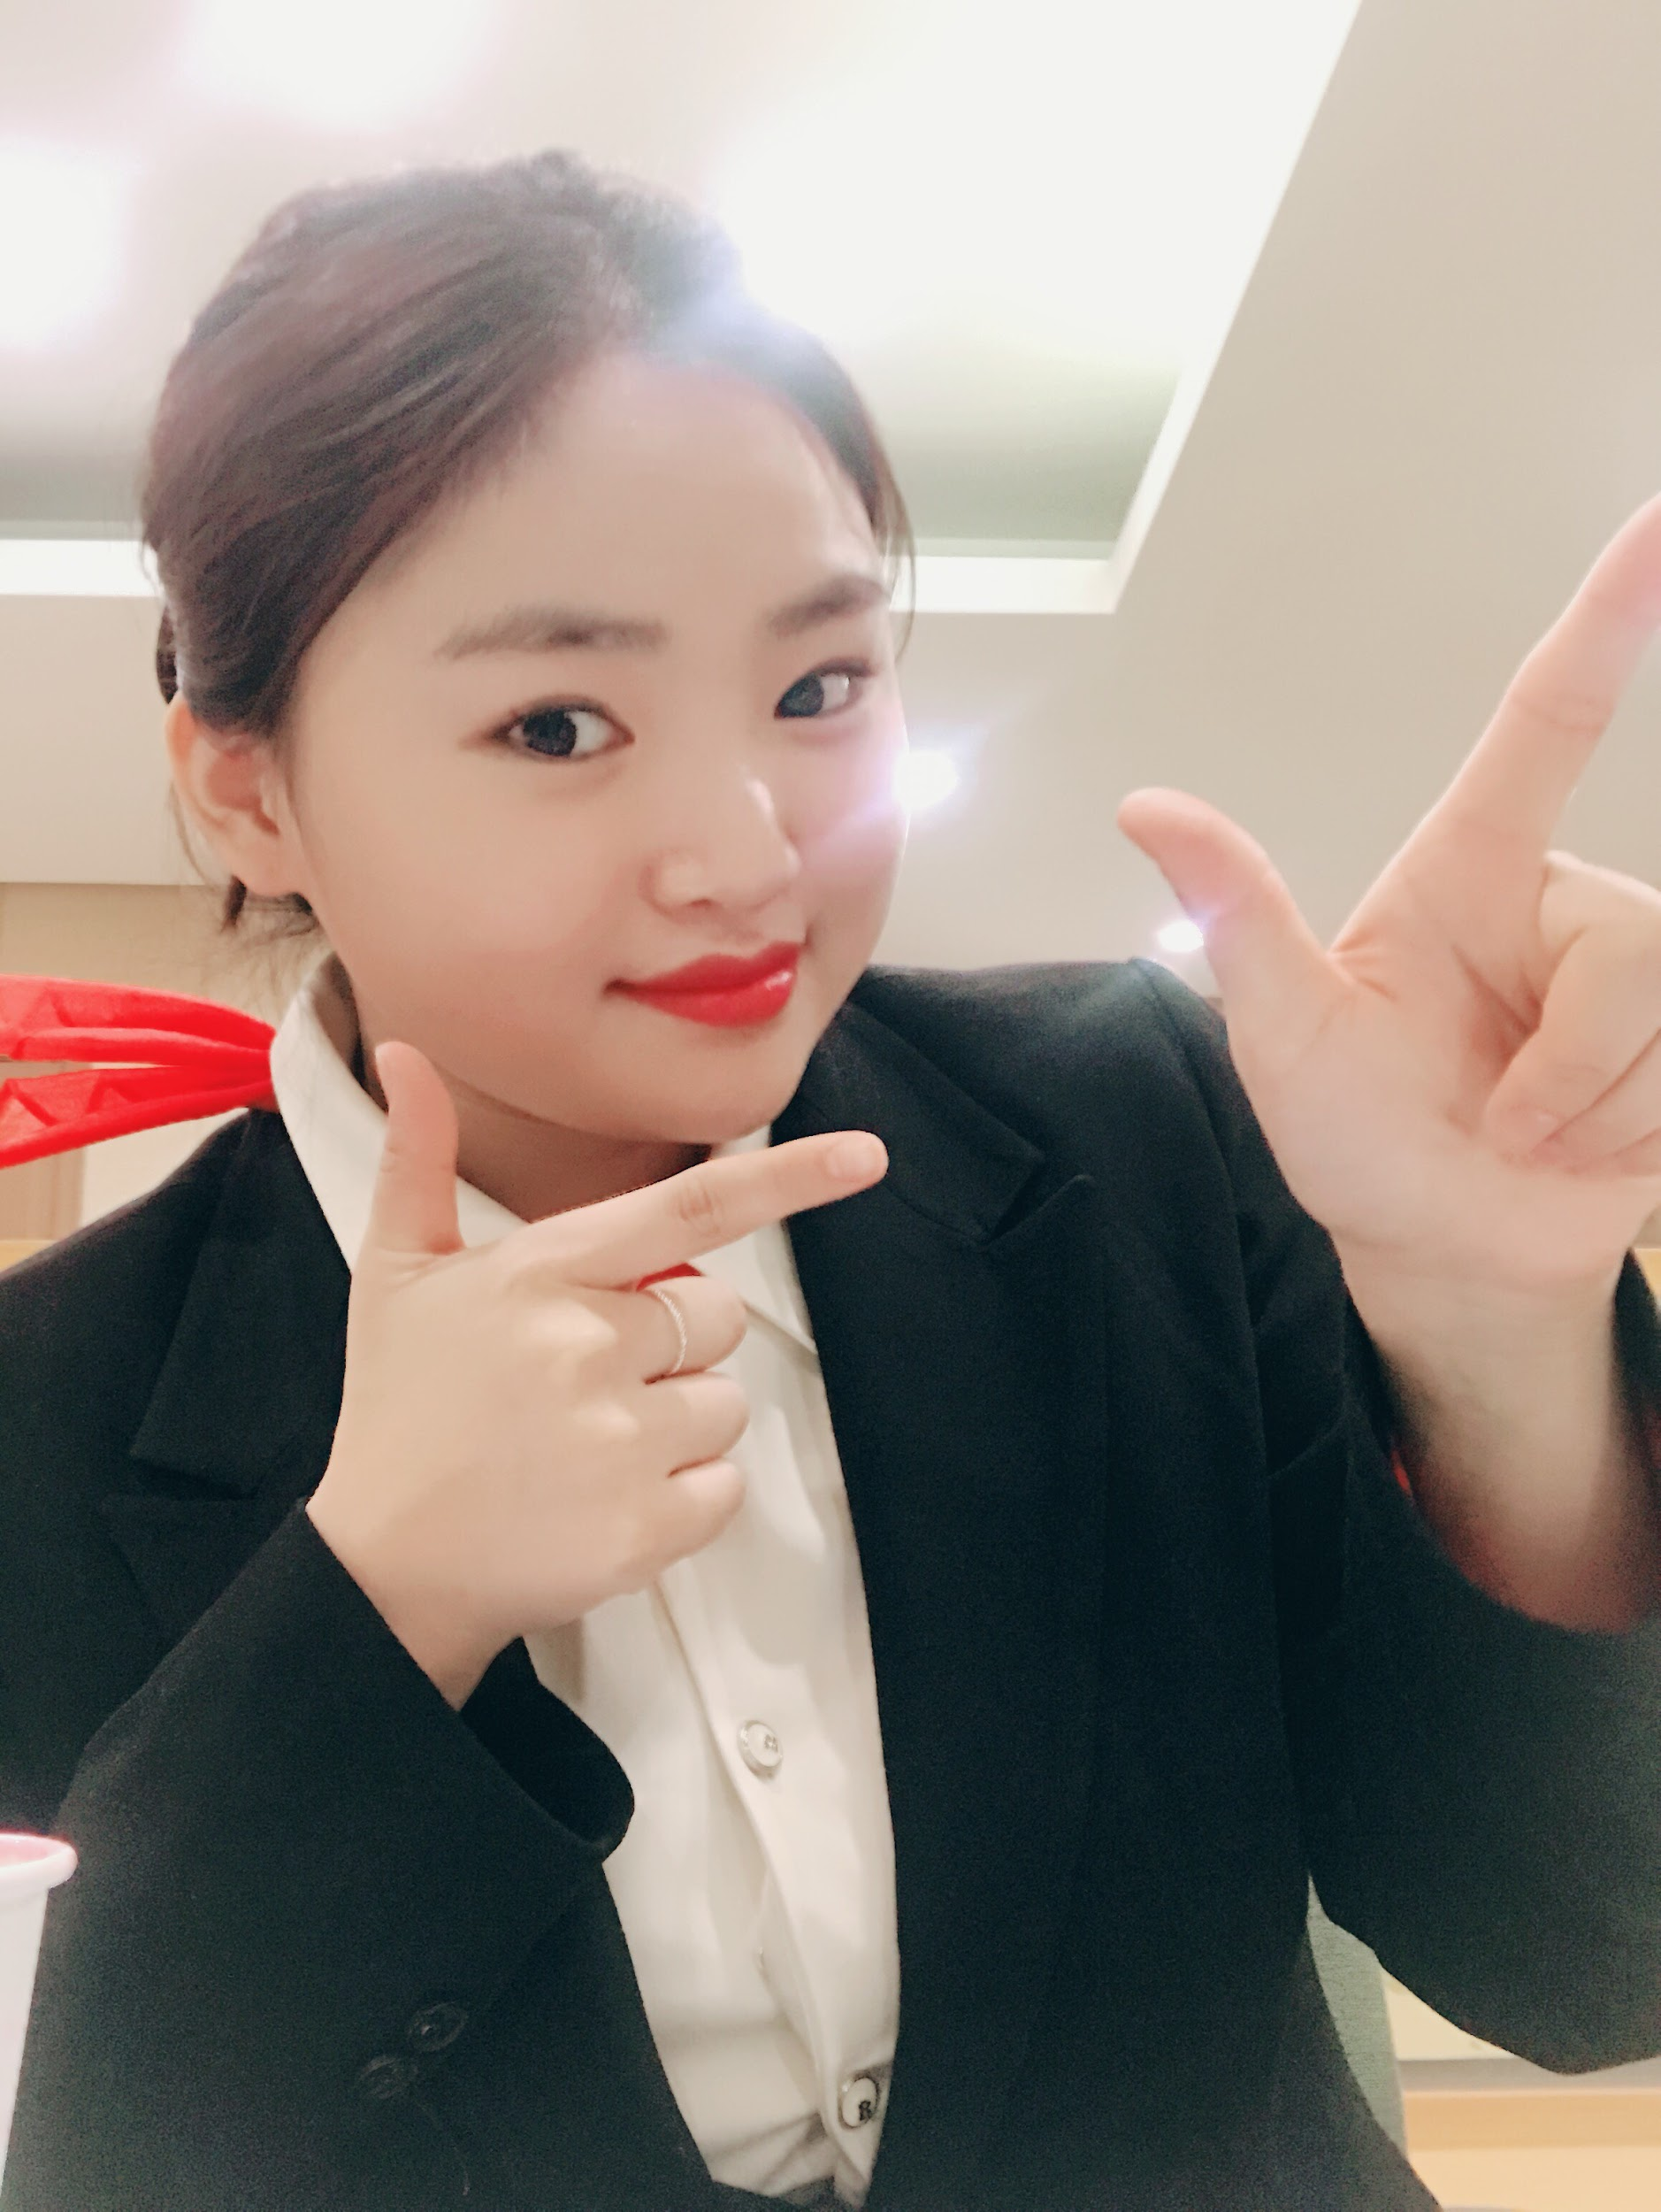
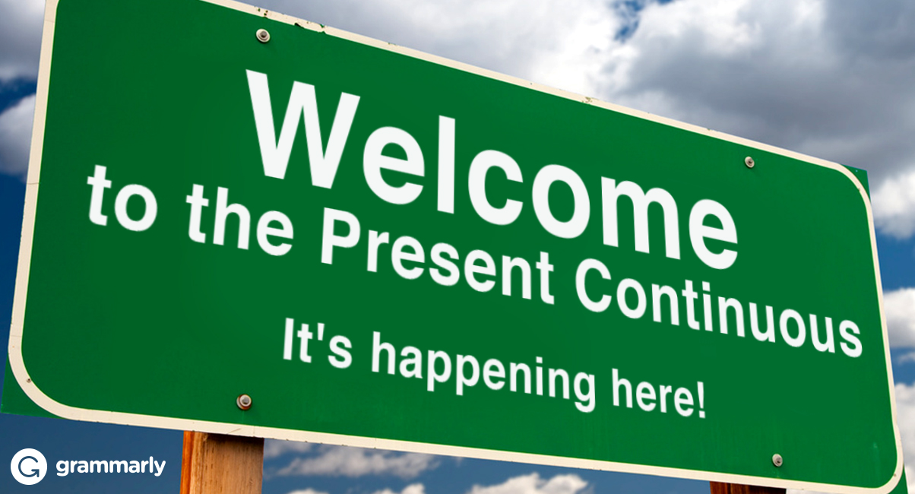
Camping
Present continuous
Jennifer

Slide 2
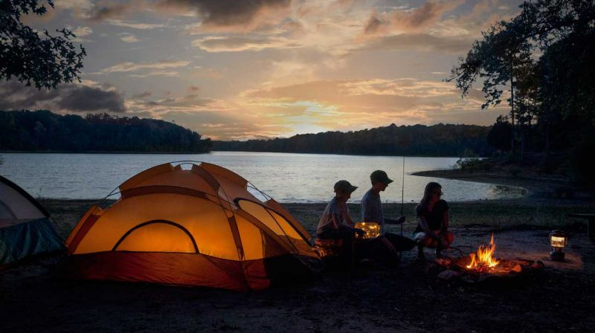

Slide 3
Camping
https://www.youtube.com/watch?v=QhOXN9Bdd-Y&sns=em
Describe the video
Use ‘Present continuous’
Ex. She is sitting.

Slide 4
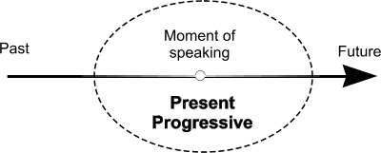
Present continuous - Timeline

Slide 5
Present continuous - Timeline

Slide 6
Present continuous - Substitution table
Affirmative
I | am | walking cooking eating popcorn. setting up the tent playing
He She It | is
You They We | are

Slide 7
Present continuous - Substitution table
Negative
I | Am not =‘m not | walking cooking eating popcorn. setting up the tent playing
He She It | is not =isn’t
You They We | are not =aren’t

Slide 8
Present continuous - Substitution table
Question & Answer
Question |  |  | Answer
Am | I | walking. cooking. eating popcorn. setting up the tent. playing. | Yes, I am / No, I am not (I’m not)
Is | he she it |  | Yes, he is/ No, he is not (he isn’t)
Are | you they we |  | Yes, they are. / No, they are not ( they aren’t )

Slide 9
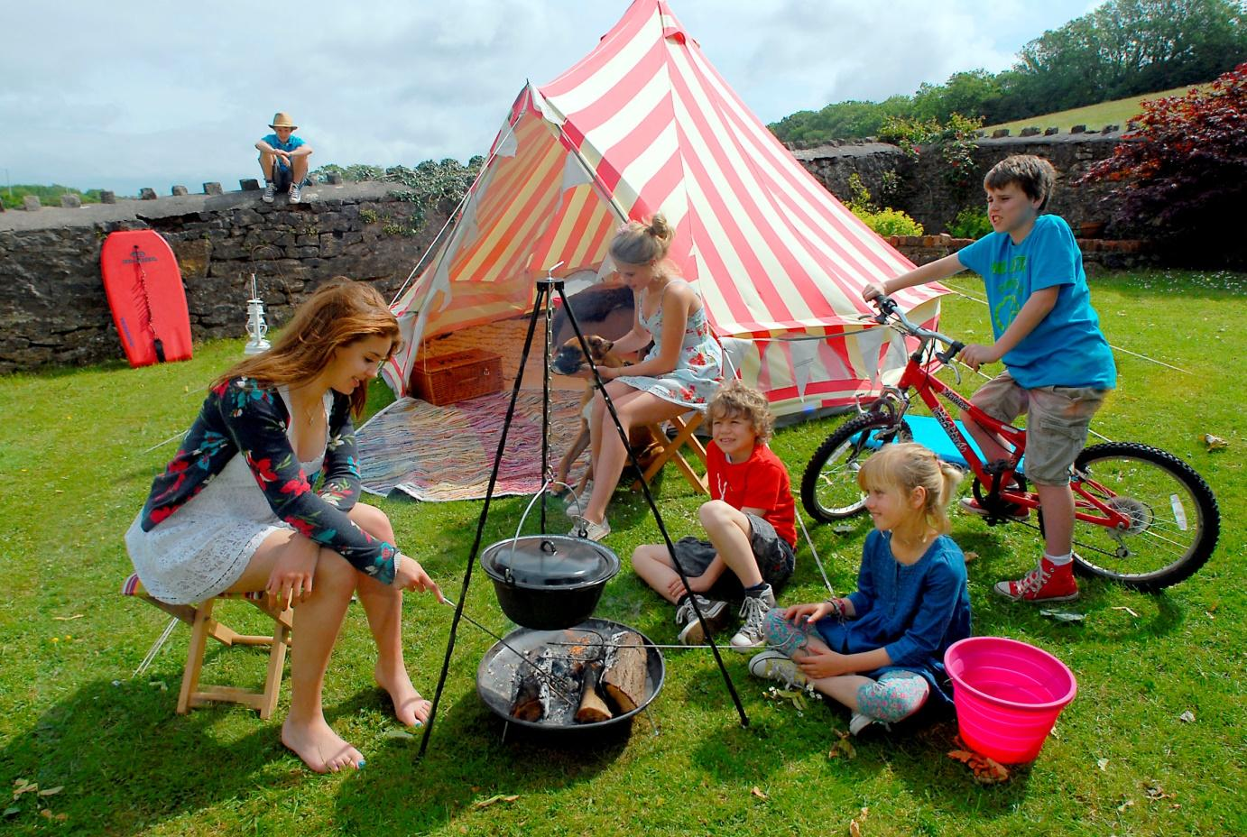
What is happening at the camping?

Slide 10
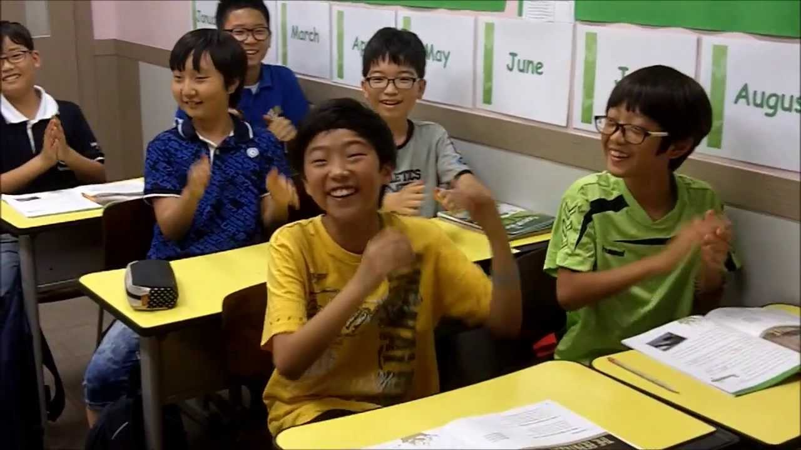
Memory game

Slide 11
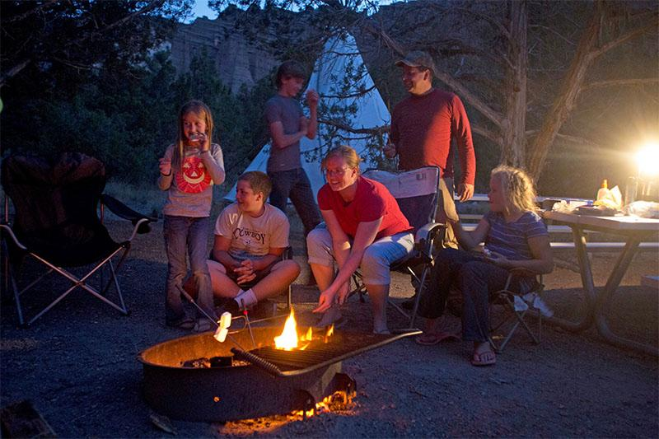
Discussion-Camping

