Slide 1
THE PRESENT CONTINUOUS IS USED:
To describe an action that is going on
at this moment:
You are studying English grammar.
You are using the Computer.

Slide 2
FORMING THE PRESENT CONTINUOUS
The present continuous of any verb is composed of two parts - the present tense of the verb to be + the present participle of the main verb.
(The form of the present participle is: base+ing, e.g. talking, playing, moving, smiling)
I | am
YOU | are
HE/SHE/IT | is |  | Verb + ing
WE | are
THEY | are

Slide 3
FORMING THE PRESENT CONTINUOUS
The present continuous of any verb is composed of two parts - the present tense of the verb to be + the present participle of the main verb.
(The form of the present participle is: base+ing, e.g. talking, playing, moving, smiling)
I | am
YOU | are
HE/SHE/IT | is | not | Verb + ing
WE | are
THEY | are

Slide 4
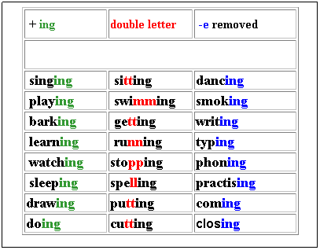

Slide 5
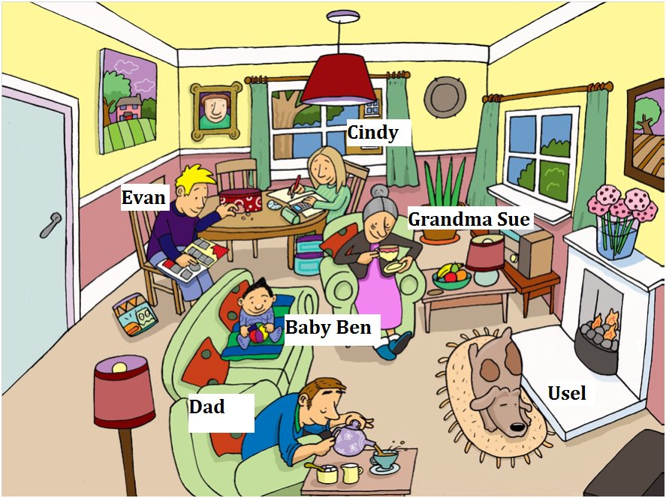

Slide 6
