Slide 1
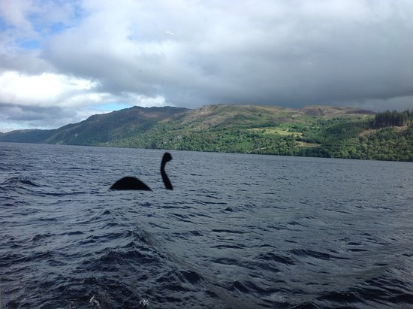

Slide 2
Lock Ness monster, Nessie

Slide 3
Lock Ness Exploring
I am a Korean guy (who was) invited to a Scottish organization 5 years ago.
I have been to a town (which is) called Inverness (that is) an entrance to Loch Ness.
Every year many people come to Loch Ness where they want to see a friendly monster, Nessie.

