Slide 1
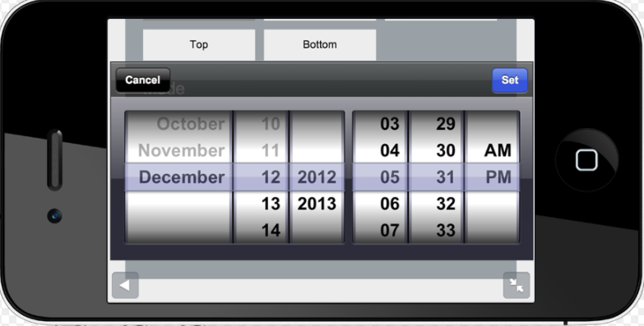

Slide 2
In / On/ At
In March, In 2003, In the winter
In + month, year or season
In + morning, afternoon, evening - In the morning, In the evening
On April 2, On March 3, 1999, On Saturday
On + date (with the year or without it) or day of the week
At 3:30 p.m., At 4:01, At noon
At + clock time, midnight, noon, night

