Slide 1
Egypt

Slide 2
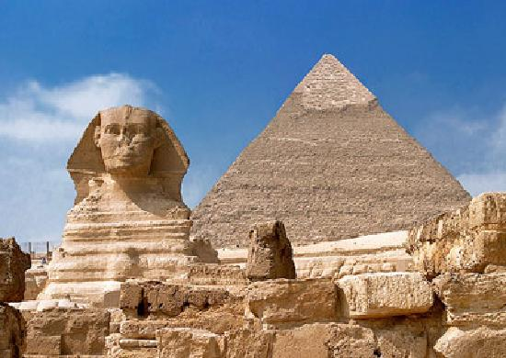

Slide 3
France

Slide 4
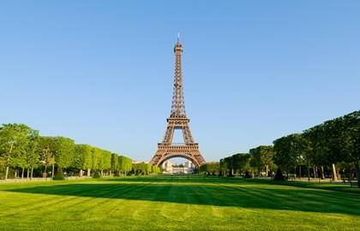

Slide 5
China

Slide 6
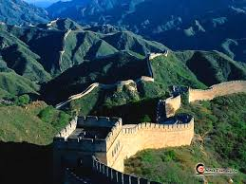

Slide 7
