Slide 1
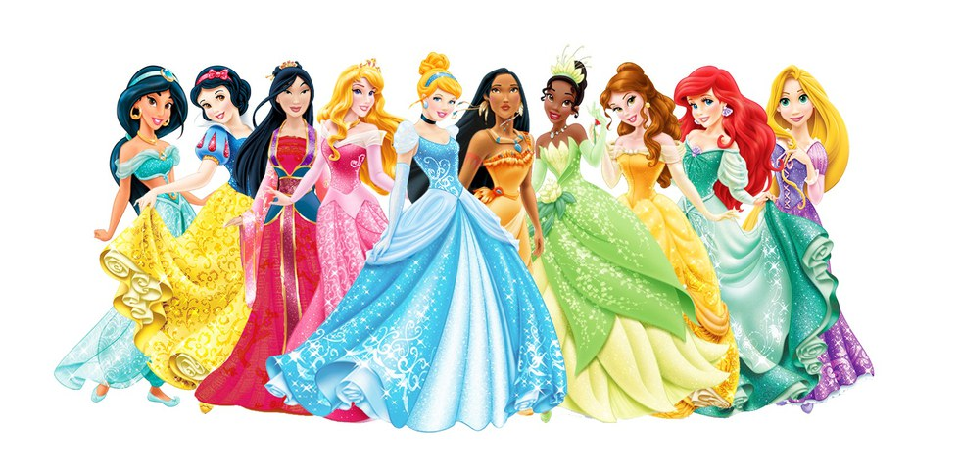

Slide 2
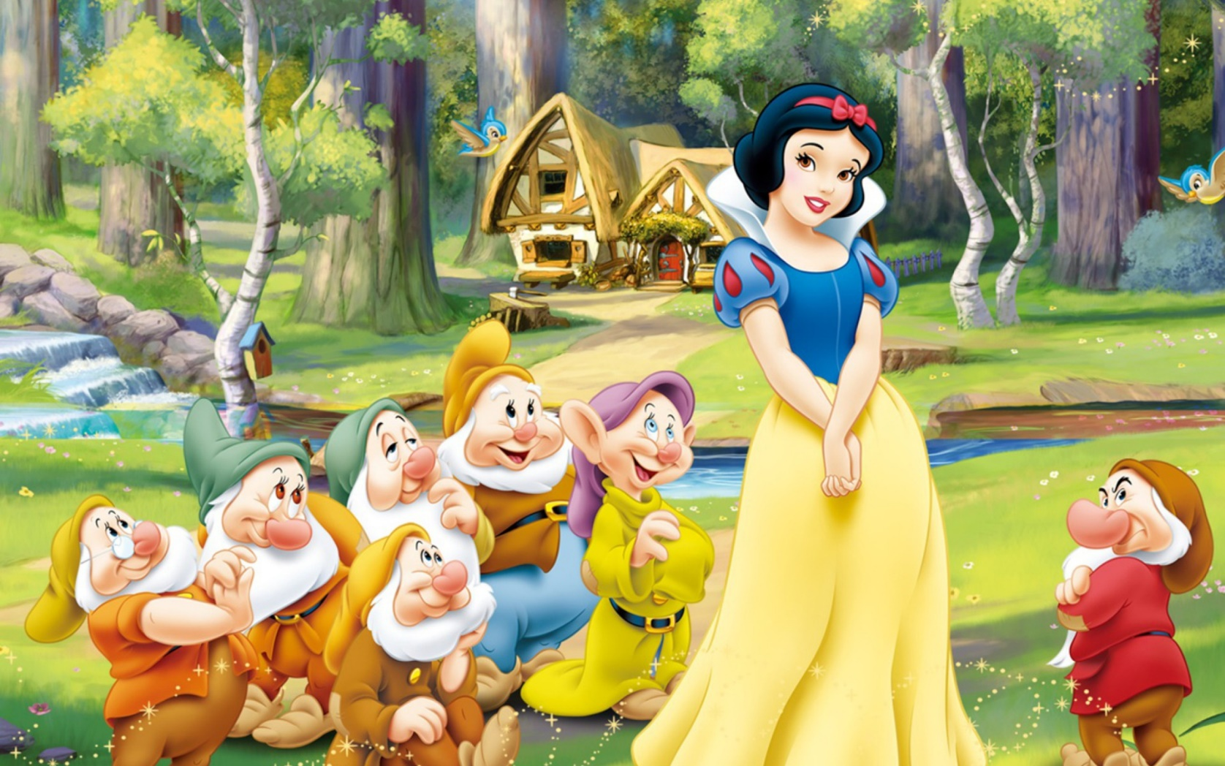

Slide 3
Snow White and the Seven Dwarfs

Slide 4
Key Vocabulary
Coffin (noun): a box or case to hold a dead body for burial
Majesty (noun): the quality or state of being impressive and dignified.
Splendor (noun): an impressive feature, things that are very beautiful or impressive.
Dislodge (verb): to force out of a place of resting, hiding, or defense.
Dwarf (noun): a creature in legends that is usually pictured as a small person who is skilled at some craft.

