Slide 1
We Are Twins
Words to know

Slide 2
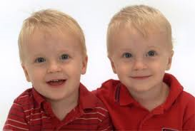
Twin

Slide 3
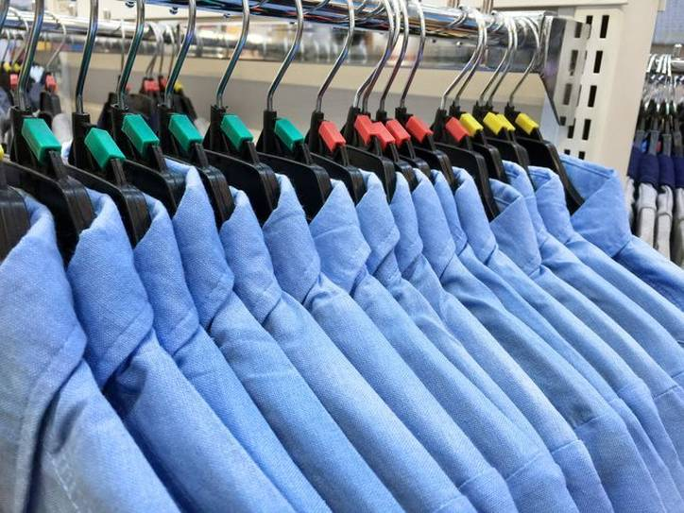
Same

Slide 4
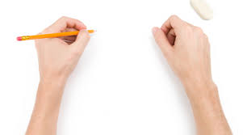
Left - handed

Slide 5
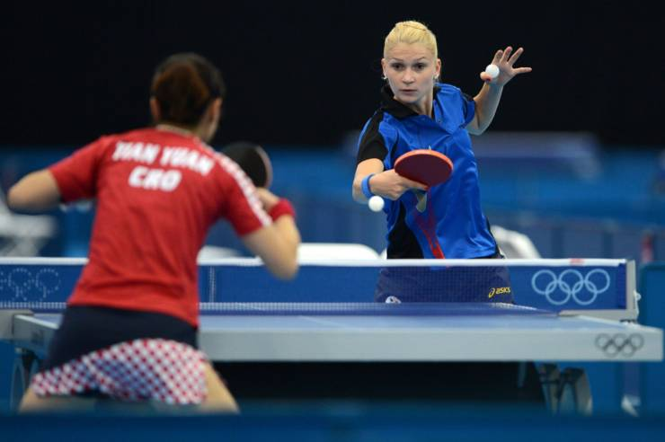
Ping-pong

Slide 6
Tennis

Slide 7
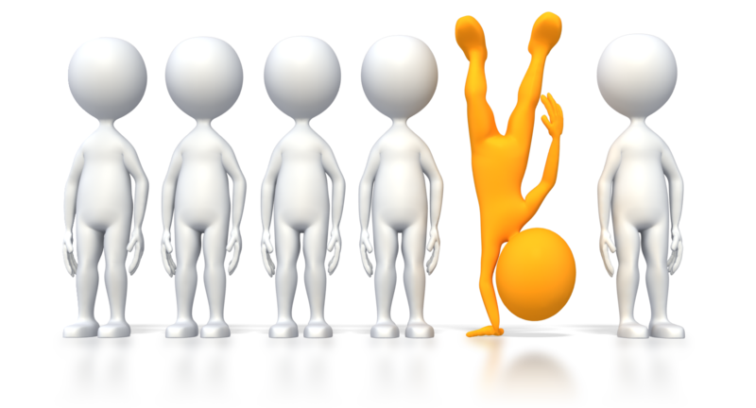
Different

Slide 8
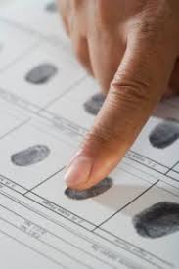
Fingerprint

