Slide 1
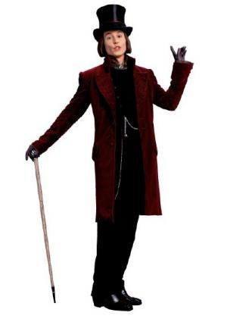
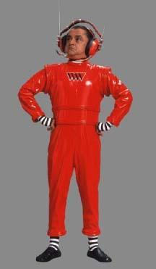

Slide 2
More ~~ =

Slide 3
umpa lumpa is shorter
than willy wonka
willy wonka is taller
than umpa lumpa

Slide 4
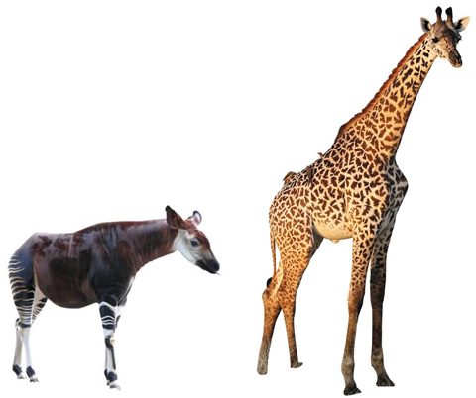
Giraffe’s neck is longer
than Okapi’s neck
Okapi’s neck is shorter
than Giraffe’s neck

Slide 5
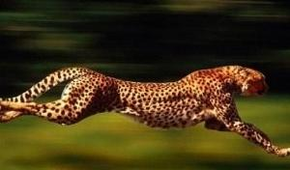
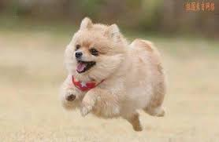
Chita is faster than dog
Dog is slower than Chita

Slide 6
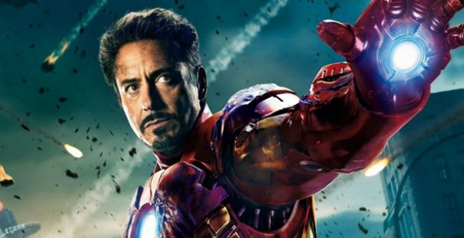
longer
Rapunzel’s hair is _____
than Iron man’s hair
Iron man’s hair is _____
than Rqpunzel’s hair
shorter

Slide 7
Make your own sentences!

Slide 8
More ~~ =
~~er
More + er
(X)

Slide 9
more long =
longer
more hard =
harder
more slow =
slower
more thin =
thinner

