Slide 1
Cafe Role Play
Joseph Kang
Introduction
Key Vocabulary
Instructions

Slide 2
Introduction
In today’s activity we will do a Cafe role play practicing to order drink and food from an English speaking country.
We will learn the key words, and dialogue patterns that is often used at a cafe.
These dialogues could also be applied to other shops or restaurants.

Slide 3
Key Vocabulary
Cafe
Coffee
Syrup
Espresso
Americano
Latte
Mocha

Slide 4
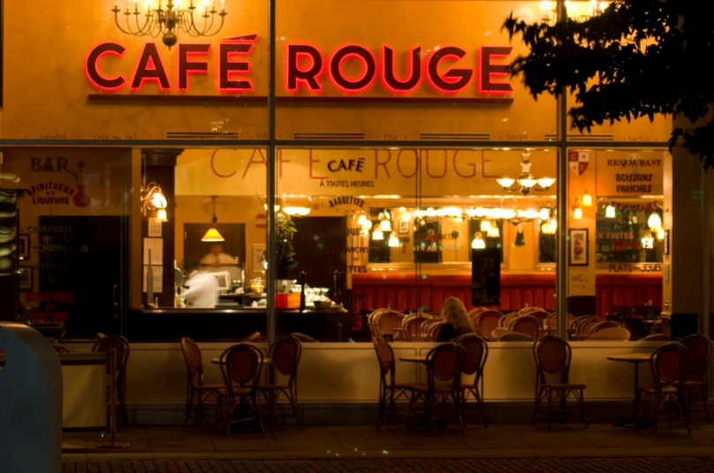
Cafe
A small restaurant selling light meals and drinks.

Slide 5
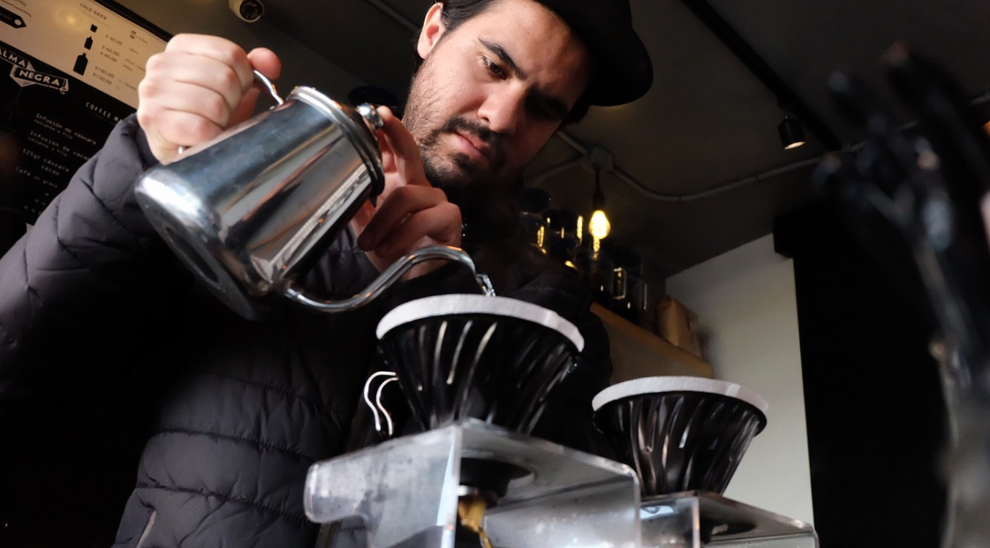
Barista
A person whose job involves preparing and serving different types of coffee.

Slide 6
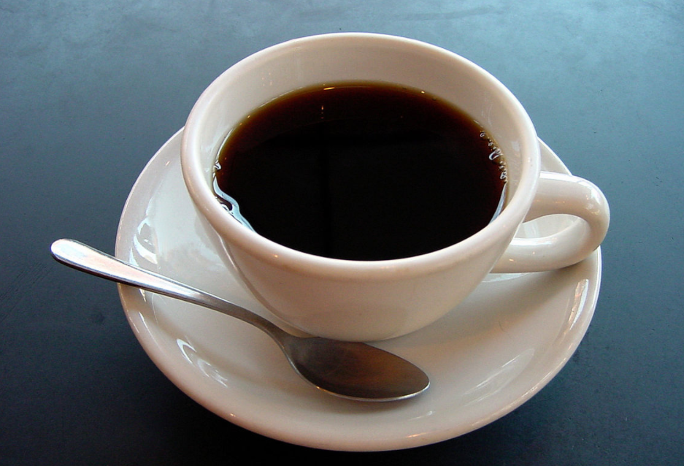
Coffee
A drink made from the roasted and ground seeds (coffee beans) of a tropical shrub.

Slide 7
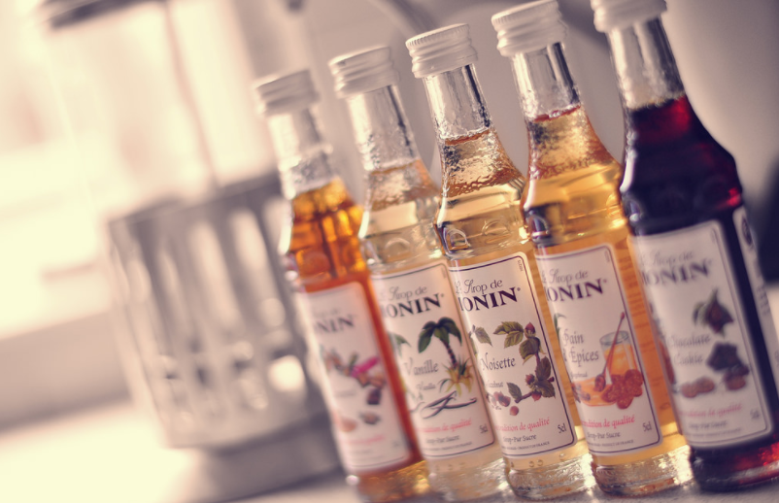
Syrup
A thick sticky liquid derived from a sugar-rich plant, especially sugar cane, corn, and maple. Very sweet.

Slide 8
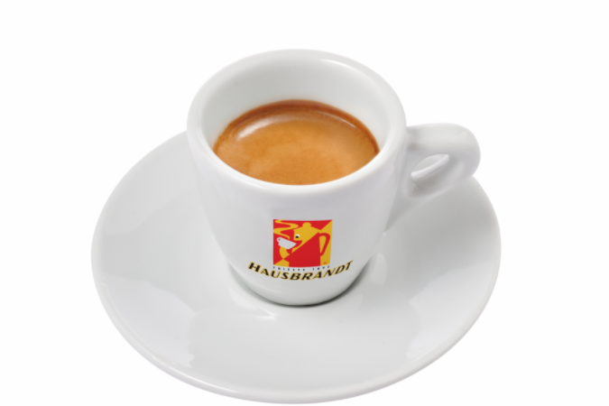
Espresso
A type of strong black coffee made by forcing steam through ground coffee beans.

Slide 9
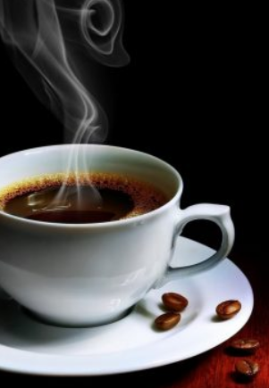
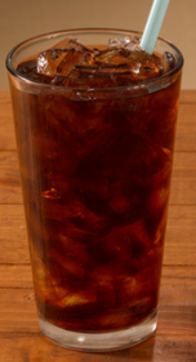
Americano
A drink of espresso coffee diluted with water, can be served hot or cold.

Slide 10
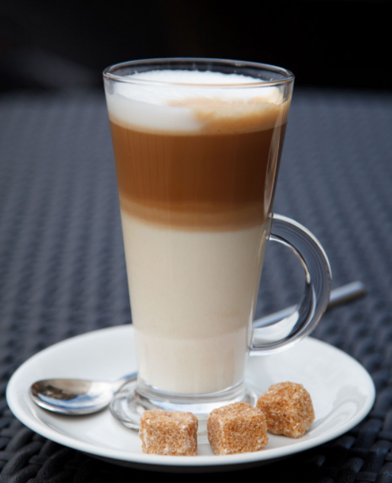
Latte
A type of coffee made with espresso and
hot steamed milk, milkier than a cappuccino.

Slide 11
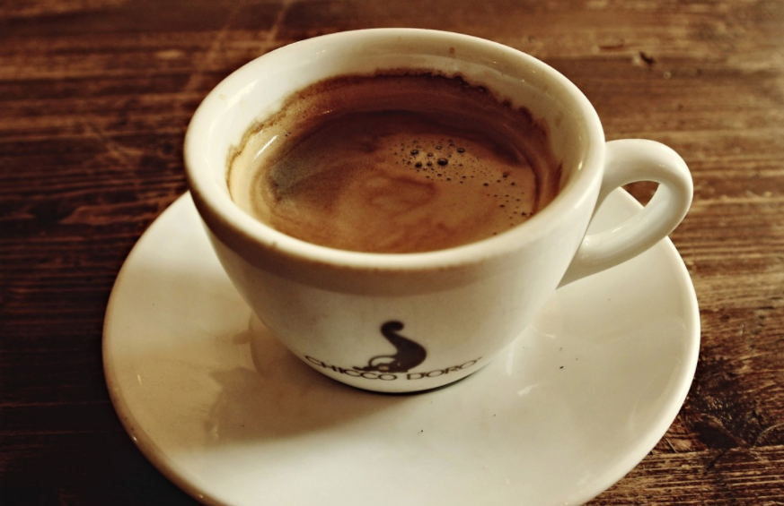
Mocha
A drink or flavouring made with mocha, typically with chocolate added.

Slide 12
What is your favorite type of Coffee?
Do you have a favorite type of coffee drink?
Do you have a favorite cafe that you visit?
Do you like to drink hot or cold coffee?
Do you like to drink coffee alone or with others?
Have you ever had your coffee order come out wrong?

Slide 13
Introductions
You will be given a setting, and each students will be given a role.
Setting: During a busy lunch hour, a customer orders their favorite drink. However the Barista made a mistake and got the customer a wrong order. The Barista paniks and the manager has to step in and figure out what went wrong with the orders to resolve the problem.
Roles are: Barista, Customer, and Manager

Slide 14
Work Citation
https://www.flickr.com/photos/sheffield_tiger/3547257320
https://pixabay.com/ko/%EC%BB%A4%ED%94%BC-%EB%B0%94%EB%A6%AC-%EC%8A%A4%ED%83%80-%EB%A9%95%EC%8B%9C%EC%BD%94-2344797/
https://commons.wikimedia.org/wiki/File:A_small_cup_of_coffee.JPG
https://commons.wikimedia.org/wiki/File:Hausbrandt_Espresso.JPG
https://www.flickr.com/photos/pixeljockeyth/11861727204
https://www.cariboucoffee.com/menu-nutrition/beverage-food-detail?id=1448&type=drink
http://drinsomniacs.com/product/cafe-americano/
https://www.publicdomainpictures.net/view-image.php?image=9092&picture=coffee-latte
https://pxhere.com/en/photo/686059

