Slide 1
Simple Present Tense

Slide 2
Simple Present Tense is used to….
Express a habit (like a routine)
e.g: I wake up at 8 am
Describe a general truth (be verb)
e.g: Tree is tall

Slide 3
Expressing a habit based on appointed location or time
I wake up at 8am
He wakes up at 8am
You do laundry on Monday
She does laundry on Monday
They drive to work
Billy drives to work
We go to school
Sally goes to school

Slide 4
What is third person?

Slide 5
Conjugating Third-Person Singular
Add -s at end of main verb
I drink water he drinks water
You drive to work he drives to work
But add -es to verb that ends with -ss, -sh, -ch, -x, -z, -o
Kiss, wash, search, fix, frizz, go
Kisses, washes, searches, fixes, frizzes, goes
But for verbs ending with consonant + y, change -y to -ies
Cry, dry, try, fry, fly, worry,
Cries, dries, tries, flies, worries
But with verbs ending with vowel + y end it with usual -s
Play, Pay, Say, Enjoy, Stay
Plays, Pays, Says, Enjoys, Stays

Slide 6
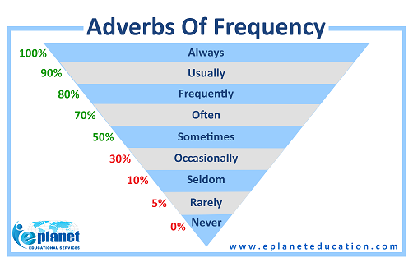
Adverb of Frequency

Slide 7
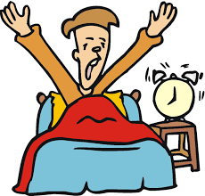
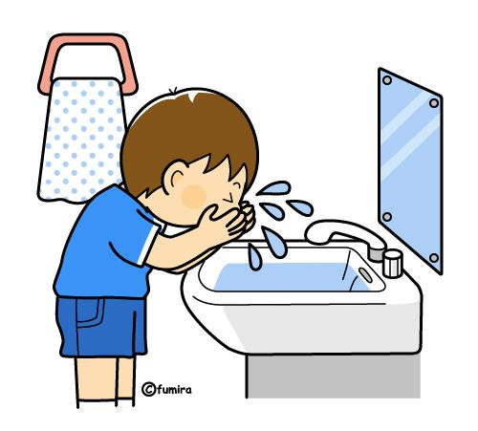
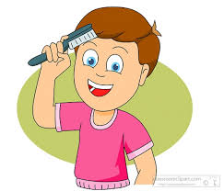
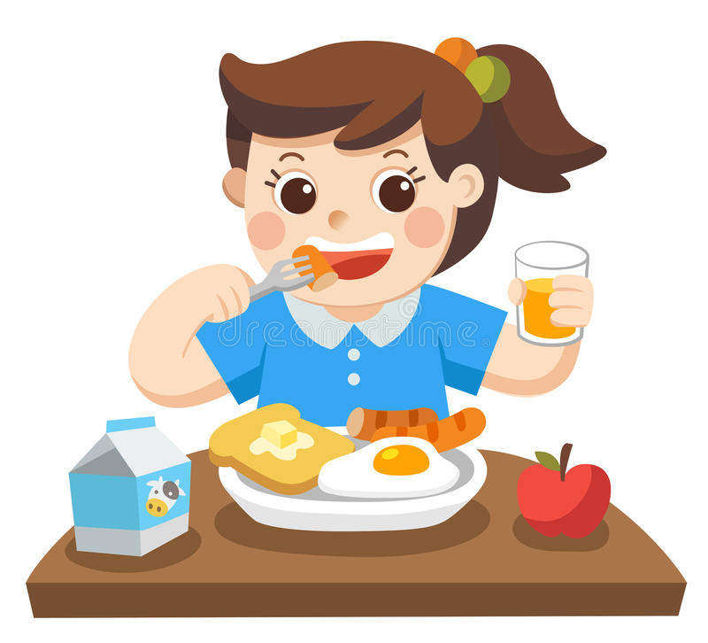
What do you do in the morning?
Wake up in the morning
Wash face in the morning
Brush hair ….
Eat Breakfast...

