Slide 1
CLUE
Who is wearing

Slide 2
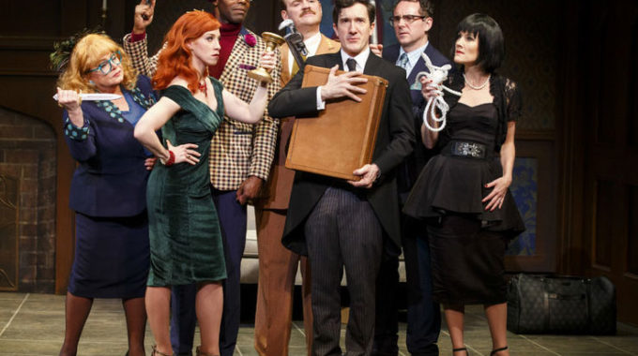
Describe?

Slide 3
Rule EXPLANATION
This is a guessing game ‘who, where, how kill SWAN ☹’
1. Hide a card from each category ( 3 cards hidden)
2. Shuffle others and divide to everyone, Each get 3 cards
3. Guess, ‘who, where, how THE PERSON WAS KILLED’ MAKE a guess with what he or she wears/holds and it has to start with ‘ A PERSON WEARING(HOLDING)~~’
EX) A person wearing black pants choked Swan in the billiard room with a rope.
4. If the person sits to the right of talkers and has a card or cards that appeared in the guess, he(or she) must show ONLY THE ONE CARD to the talker in secret.
5. If the person who sits right of the talkers doesn’t have any matched card, go to the next man, If he has matched card(or cards) show one of them(or just that card) to talker secretly, until the talker can see a card.
6. If you can get answer, say clue and make a guess (no matter whose turn) if you get it, you win and game is end

