Slide 1
Inventions -Light Plants-
For VS Since
Jeong-mi, Park (Jen)

Slide 2
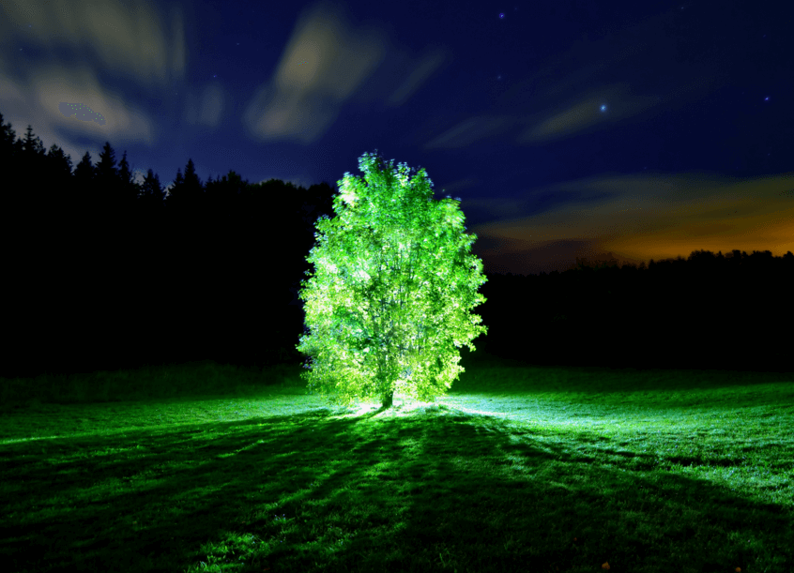

Slide 3
New plants can produce light in the dark (18th December, 2017)
Scientists have created plants that glow in the dark. They are hoping to produce plants that can light up our lives.
The scientists are from the Massachusetts Institute of Technology in the USA. They hope their discovery could lead to plant lights replacing electric lights. One day, even light that trees produce could replace street lights. Professor Michael Strano, lead author of the research, explained that his team wants to create sustainable light sources and help the environment. He said: “The vision is to make a plant that will function as a desk lamp - a lamp that you don't have to plug in. The light is ultimately powered by the energy metabolism of the plant itself.”
The researchers got the idea for their lighting plants from fireflies. They looked at the substance in fireflies that makes them glow. They created nanoparticles that contain the substance. They then put the nanoparticles into plant leaves to make them glow.
The scientists were able to make plants that glowed for nearly four hours. The research team has tested the substance on salad leaves, including spinach and watercress. Professor Strano said: “Our target is to perform one treatment, when the plant is a seedling or a mature plant, and have it last for the lifetime of the plant.” He thinks plant lights will be a part of our life in the future. He said: “We think this is an idea whose time has come.”

Slide 4
The plants glowed for nearly four hours.
For VS Since

Slide 5
For VS Since
For | Since
I’ve been waiting for two hours. | I’ve been waiting since 8:00.
Kelly has been working here for six months. | Kelly has been working here since April.
I haven’t seen Tom for three days. | I haven’t seen Tom since Monday.

Slide 6
For VS Since
For |  |  | Since
For + a period of time |  |  | Since + the start of a period
two hours | a long time | a week | 8:00 | April | lunchtime
20 minutes | six months | ages | Monday | 1986 | we arrived
five days | 50 years | years | May 12 | Christmas | yesterday

Slide 7
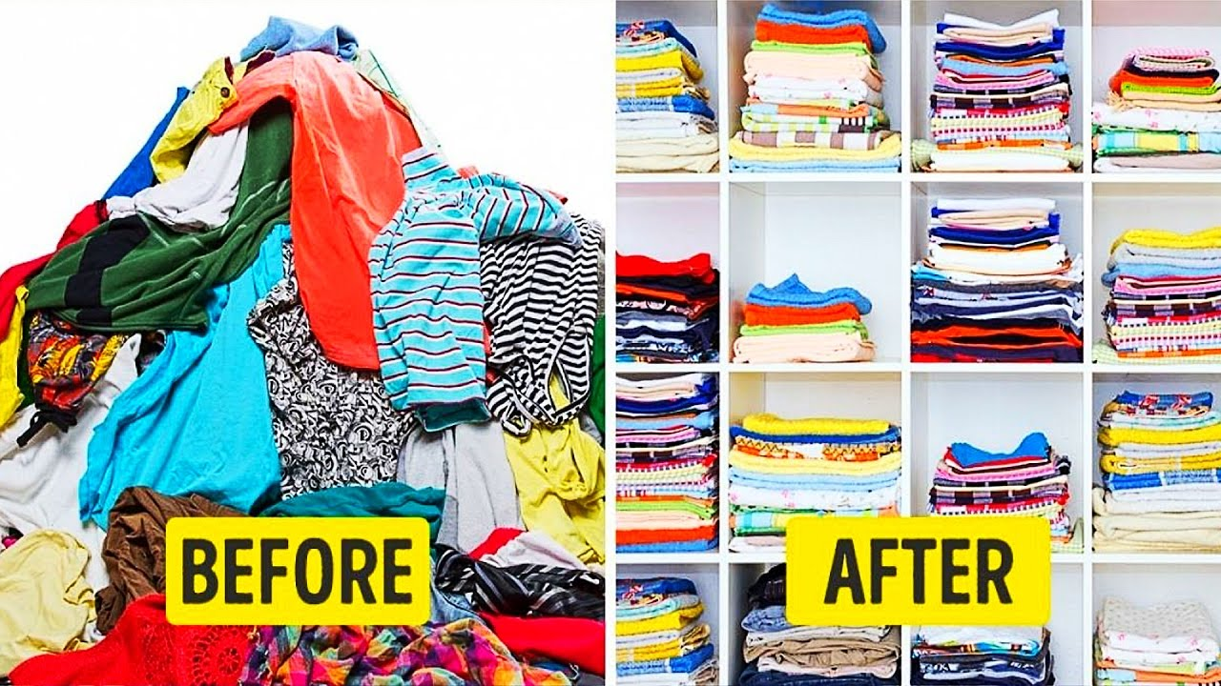
For VS Since
For OR Since?

Slide 8
For VS Since
I | have been working | for | two months
 |  |  | five years
 |  |  | a long time
 | have lived in here | since | Monday
 |  |  | 1st, January
 |  |  | I graduated school.

Slide 9
For VS Since
It’s been raining since lunchtime.
Sarah has lived in Chicago __________ 1995.
Joe has lived in Dallas __________ 10 years.
I’m tired of waiting. We’ve been sitting here __________an hour.
Kevin has been looking for a job __________ he graduated.
I haven’t been to a party __________ ages.
I wonder how Joe is. I haven’t seen him __________ last week.
Jane is away at college. She’s been away __________ last August.
The weather is dry. It hasn’t rained ___________ a few weeks.
He hasn’t eaten __________ 7 o’clock.
since
for
for
since
for
since
since
for
since

Slide 10
For VS Since
12 Inventions that shaped modern society
When was/were _________ invented?
What is the another interesting fact?

Slide 11
For VS Since
The plants glowed for nearly four hours.
Do you know when did the plant start to glow?
How long did the plants glow?
Nearly 4 hours

Slide 12
For VS Since
Mobile phones have been developed since 1917.
Do you know when did mobile phones start to develop?
Yes! In 1917

Slide 13
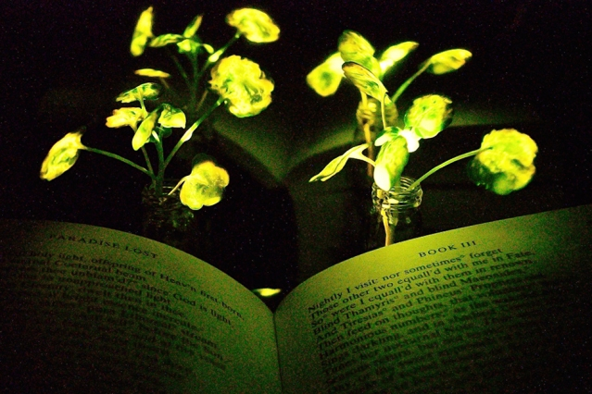
Have a nice day!

Slide 14
Reference
Sean Banville. (2017). In Breaking New English. Retrieved January 11, 2019, from
https://breakingnewsenglish.com/1712/171218-plants.html
Raymond M.& William R.S. (2009). Grammar in use Intermediate. New York, New York, USA: Cambridge University Press.
MIT Just Created Living Plants That Glow Like A Lamp, And Could Grow Glowing Trees To Replace Streetlights. (2017). In The Space Academy. Retrieved January 11, 2019, from
http://www.thespaceacademy.org/2017/12/mit-just-created-living-plants-that.html
Anne Trafton. (2017). In MIT News. Retrieved January 11, 2019, from
http://news.mit.edu/2017/engineers-create-nanobionic-plants-that-glow-1213
Anastasia Chronopoulou. (2017). In Useless daily. Retrieved January 11, 2019, from
https://www.uselessdaily.com/tech/inventions-trivia-22-inventions-that-shaped-modern-society/#.XDjb6VwzZPY

