Slide 1
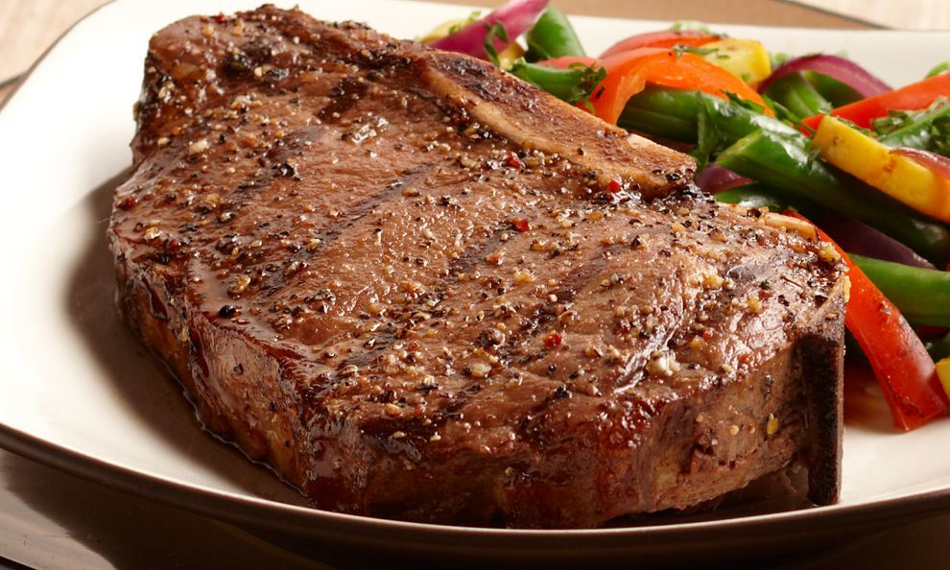
Lydia Kang

Slide 2
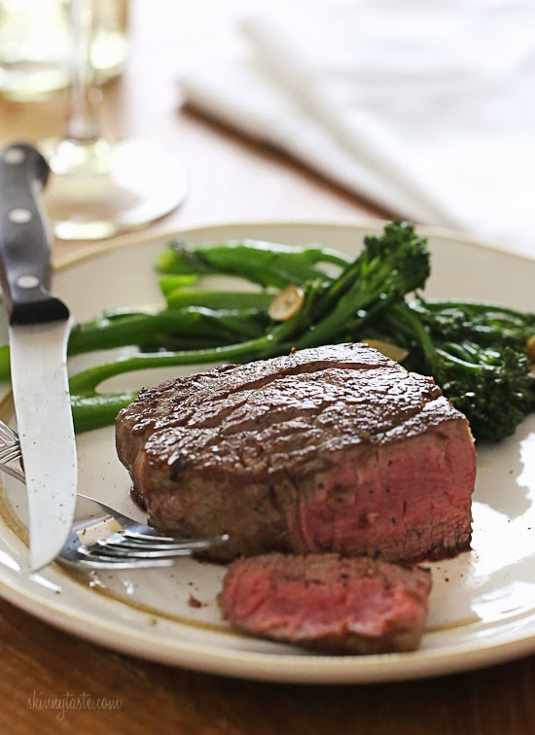
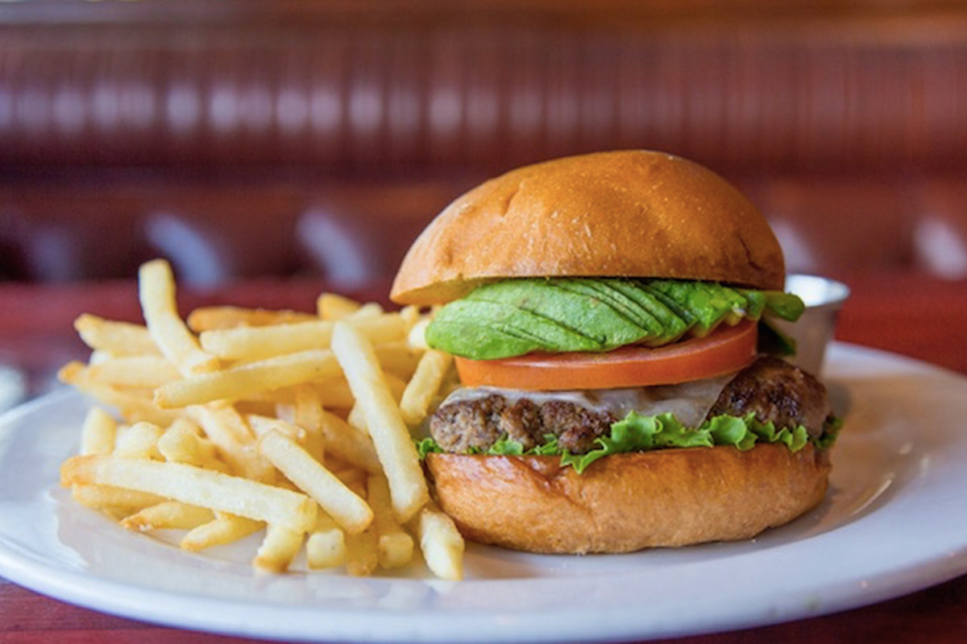
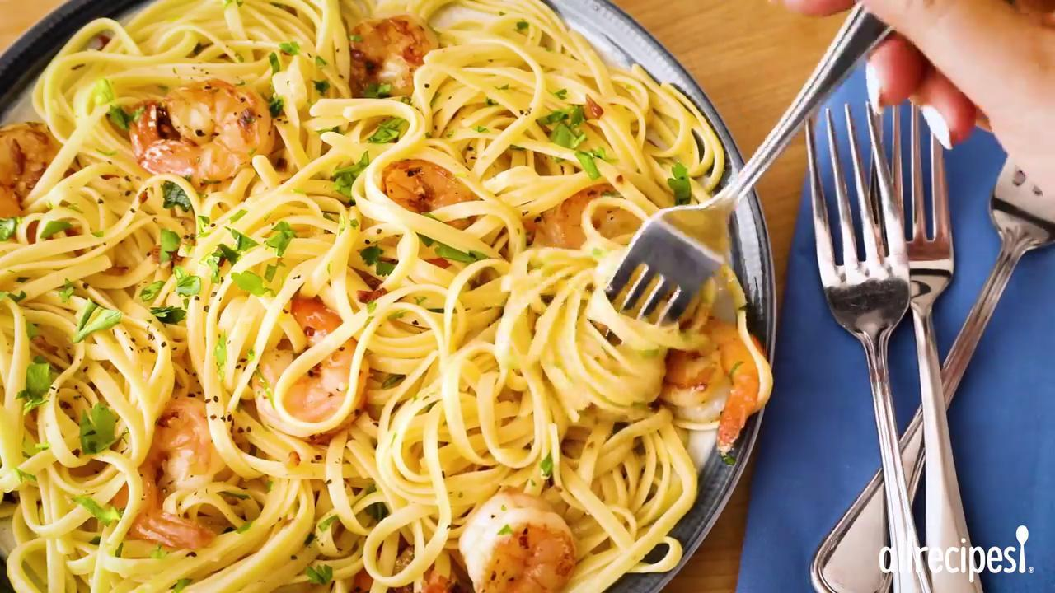

Slide 3
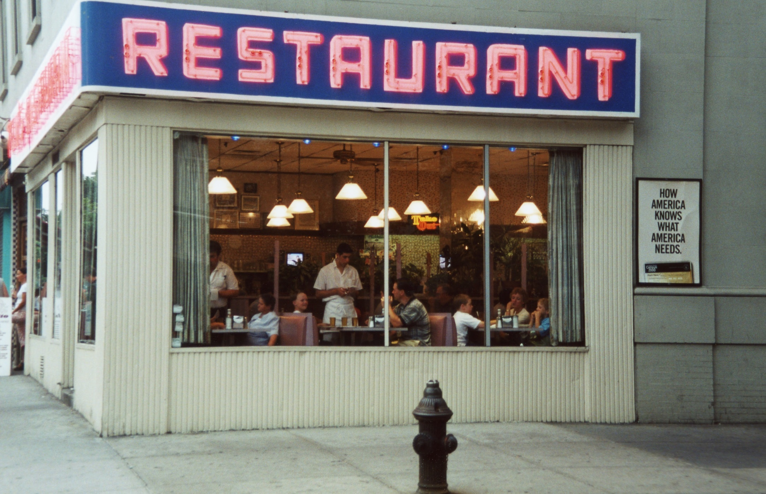

Slide 4
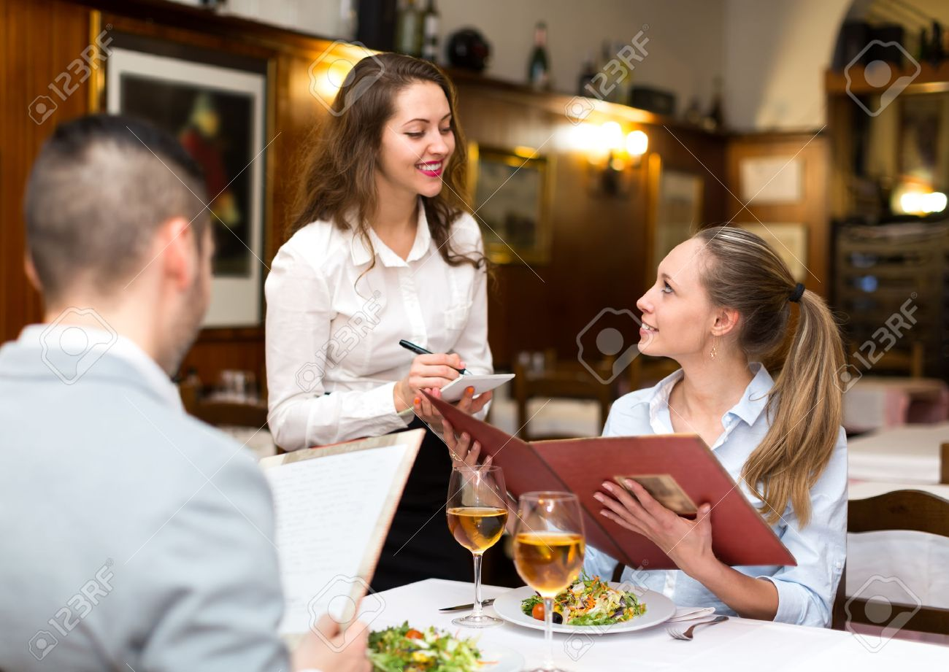
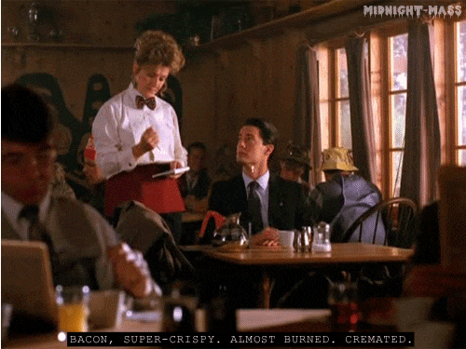
New Vocabulary
Order
Ex)
What would you like to order?
I would like to order a ________.

Slide 5
New Vocabulary
Complain

Slide 6
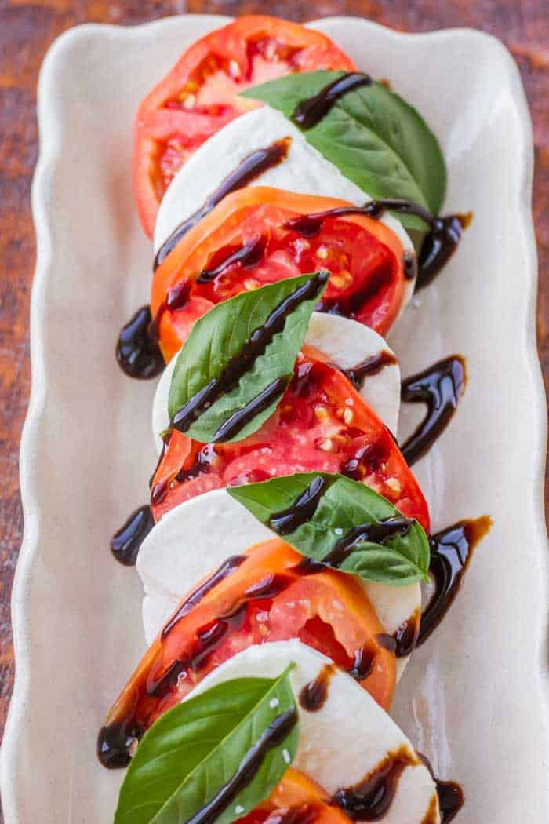
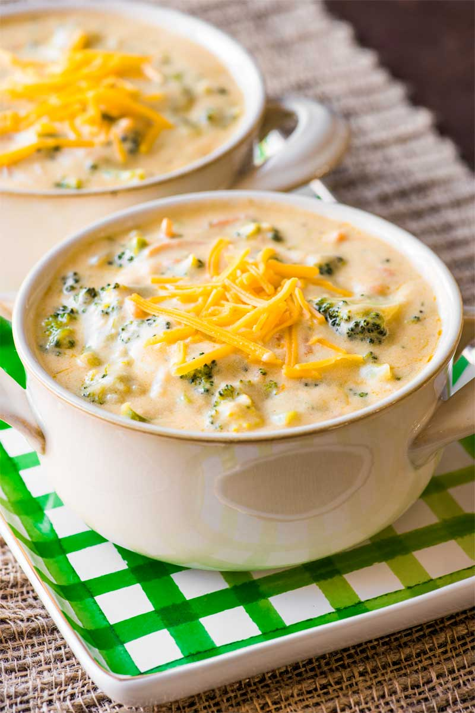
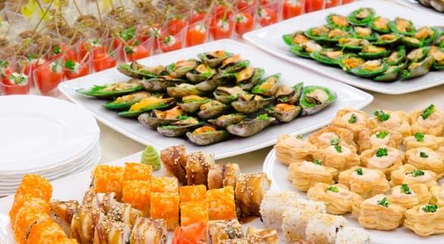
New Vocabulary
Appetizer

Slide 7
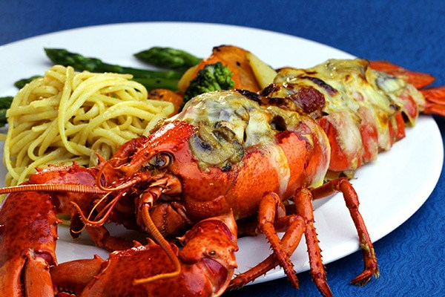
New Vocabulary
Main course

Slide 8
New Vocabulary
Apologize

Slide 9
New Vocabulary
House wine

Slide 10
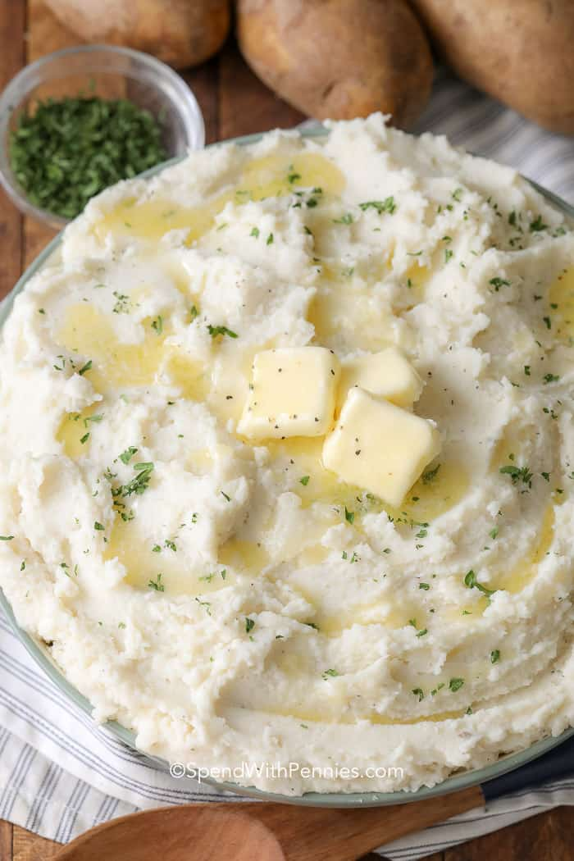
New Vocabulary
Mashed potatoes

