Slide 1
SPEAKING ACTIVITIES
BY GINA

Slide 3
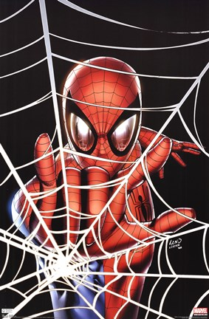
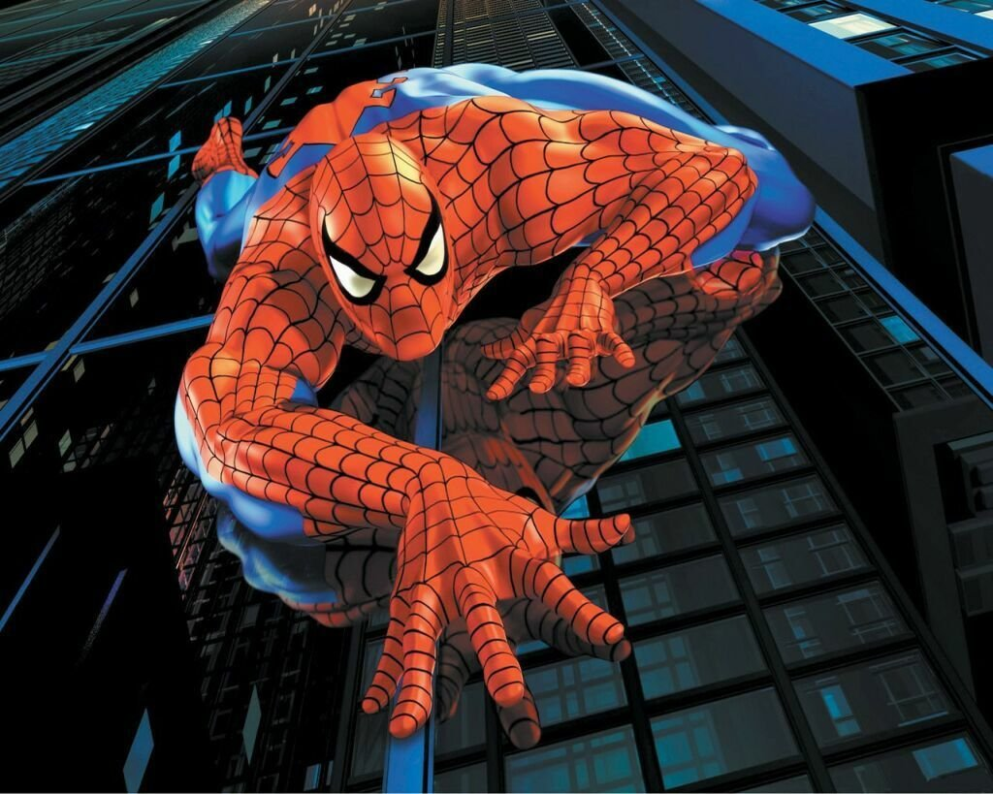
Web
Crawl

Slide 4
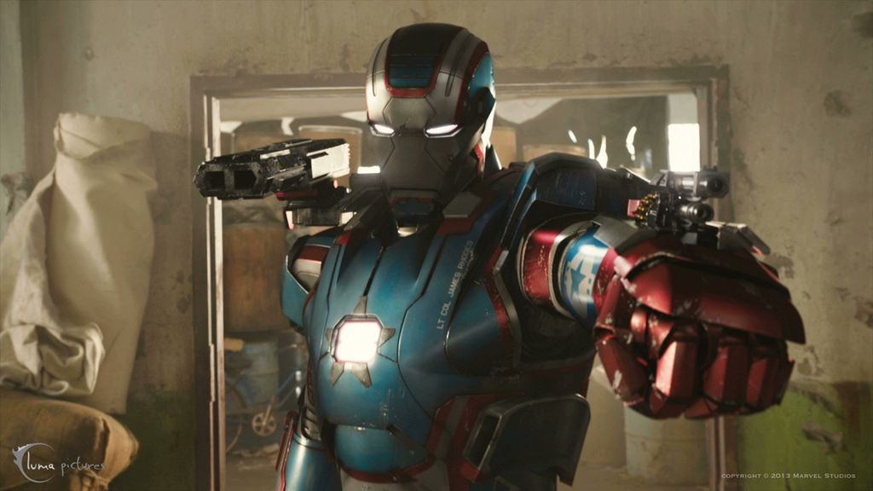
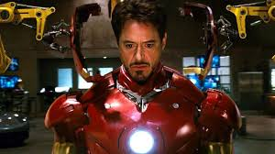
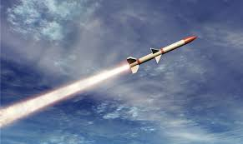
Missile
Armor

Slide 5
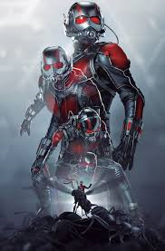
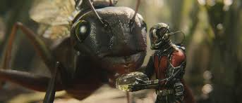
communicate
shrink

Slide 6
* Would
1. Assumption
Ex) If I were a bird, I would fly to you.
2. Asking permission(in a polite way)
Ex) Would you do that for me?
Would you be my valentine?

Slide 8
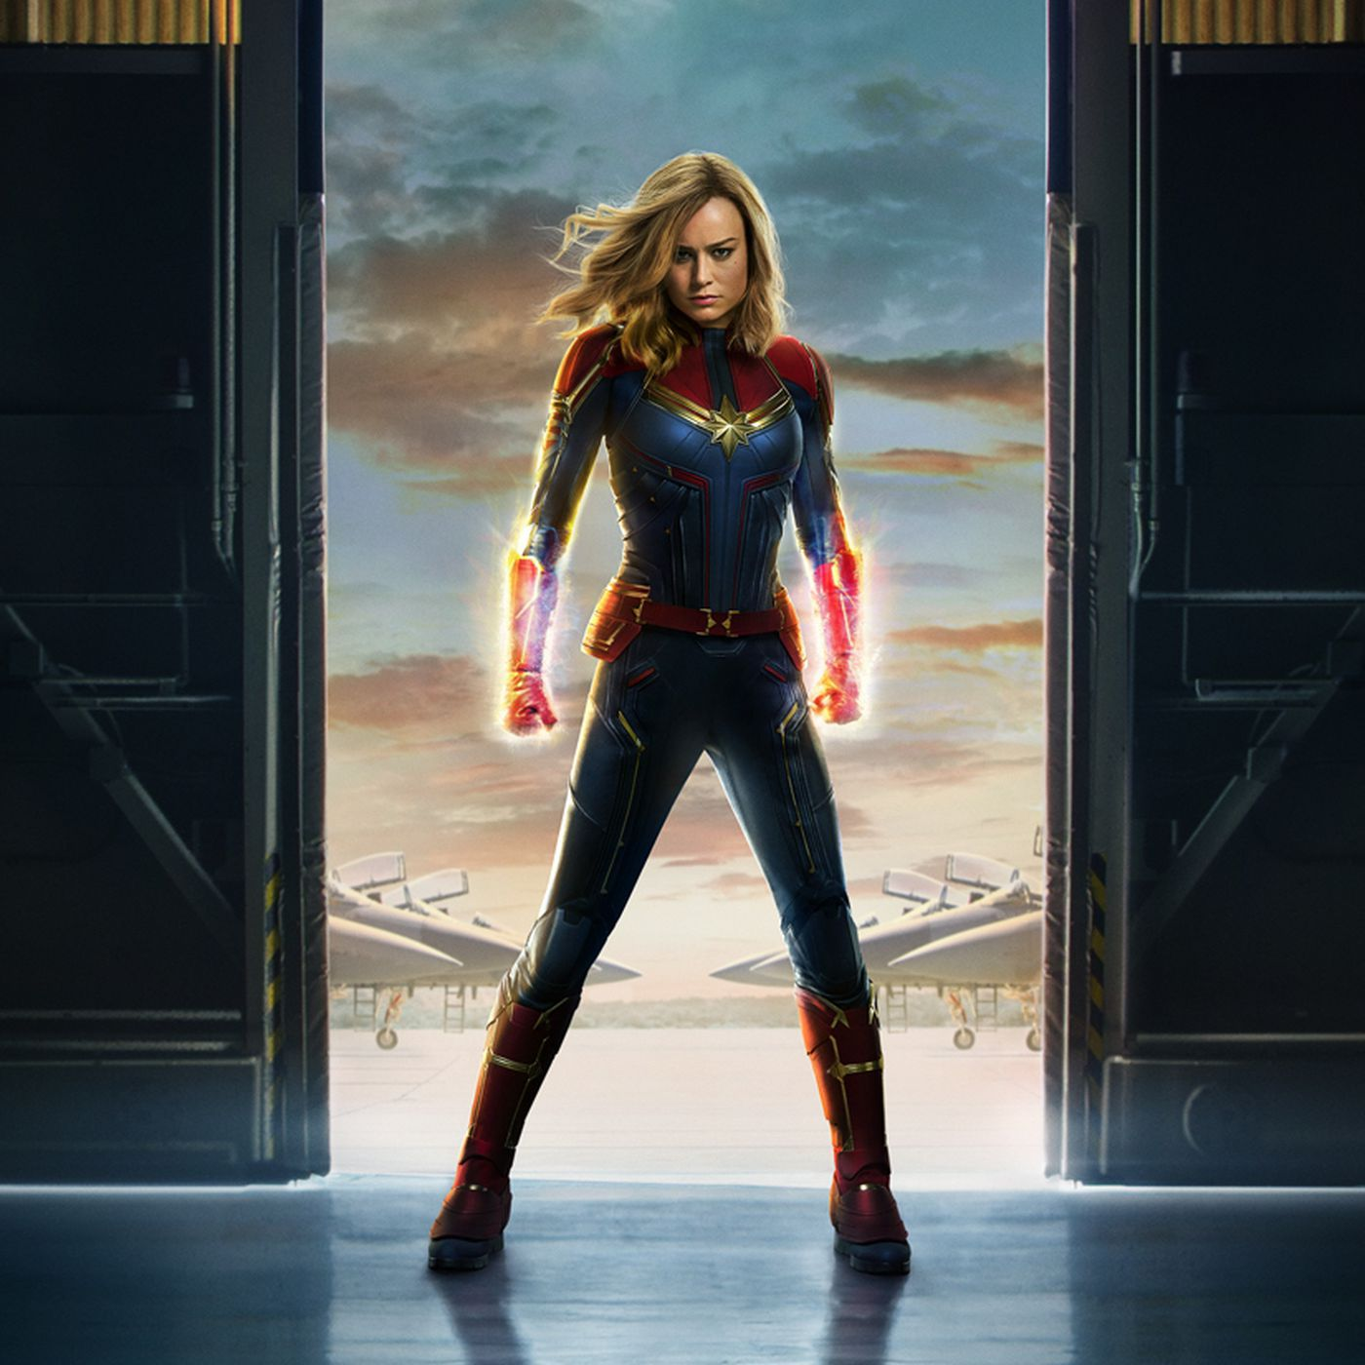
CREATE YOUR NEW SUPER
HERO

Slide 9
. Video for introducing a word of ‘superheroes’
https://www.youtube.com/watch?v=cfVY9wLKltA (00:00-00:35)
2. Video for creating new woman superhero
https://www.youtube.com/watch?v=WIbe-PmR5vk (00:00-00:40)

