Slide 1
- have to
-- is used to express certainty, necessity, and obligation.

Slide 2
I have to leave early.

Slide 3
We have to decide right now.

Slide 4
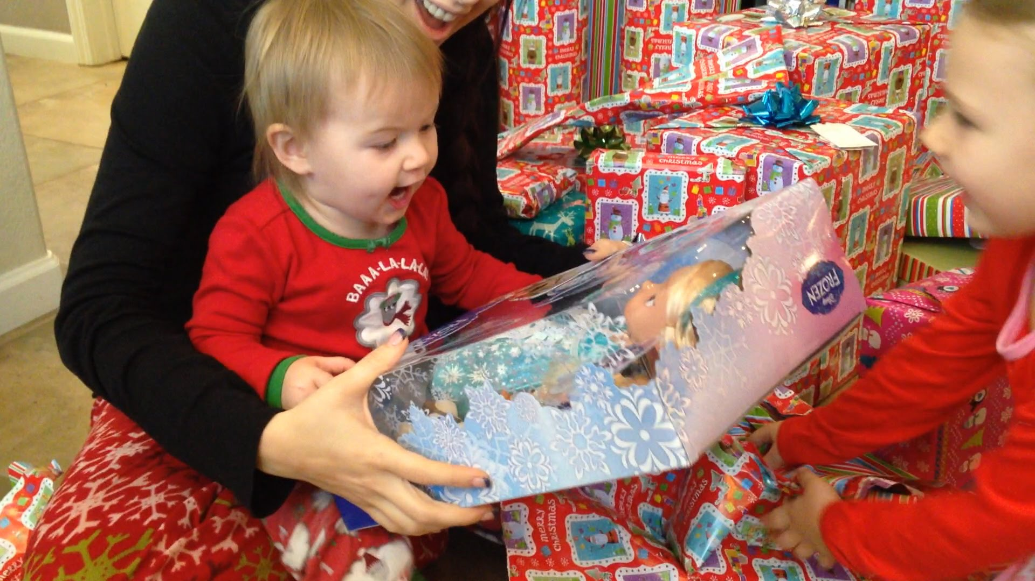
You have to give her a Christmas present .

Slide 5
Situational board game
Use - have to to answer the given situation.

Slide 6
Are you ready?

Slide 7
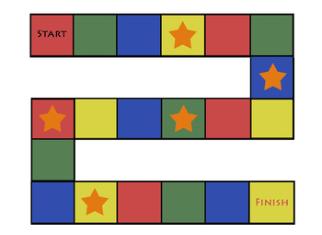
-Have to Board game
I am going to my friend’s wedding.
My mom wants to meet my bf.
You heared that it will rain tonight.
You have never tasted sushi.
Someone left a bag beside your seat.
I saw one of my student smoking.
Your friend drinks 5 bottles of soju everyday.
Skip it. Go down here. Answer this!
Say your answer and Go straight here! Stay for a moment☺
Your bf don’t like your outfit today.
You ruined your presentation today.

