Slide 1
Antonyms
Lydia Kang

Slide 3
Happy Sad

Slide 5
Sit Stand

Slide 7
Big Small

Slide 9
Hot Cold

Slide 10
Opposite Song – Dancing Time!

Slide 11
Antonyms
Words that mean the opposite
Lydia Kang

Slide 12
Antonyms Game

Slide 13
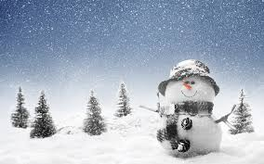
Antonyms – Fill in the blanks
The summer is ________ but the winter is _________ in Korea.

Slide 14
Antonyms – Fill in the blanks
The summer is hot but the winter is cold in Korea.

Slide 15
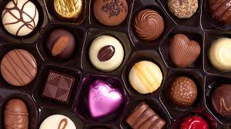
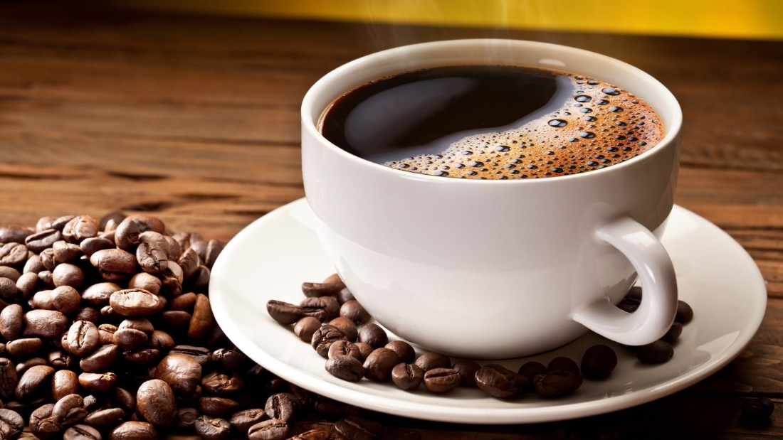
Antonyms – Fill in the blanks
Chocolate is ______ but black coffee is _________.

Slide 16
Antonyms – Fill in the blanks
Chocolate is sweet but black coffee is bitter.

Slide 17
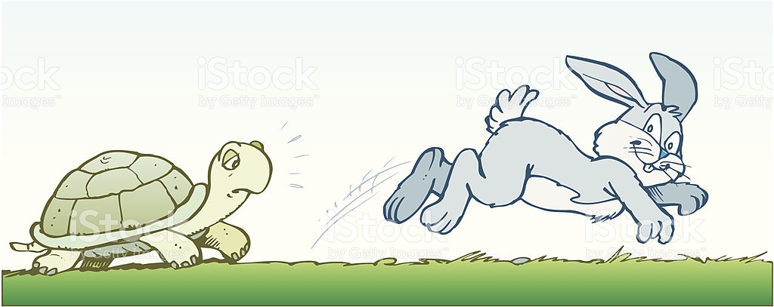
Antonyms – Fill in the blanks
The rabbit is very _______ but the turtle is very ________.

Slide 18
Antonyms – Fill in the blanks
The rabbit is very fast but the turtle is very slow.

Slide 19
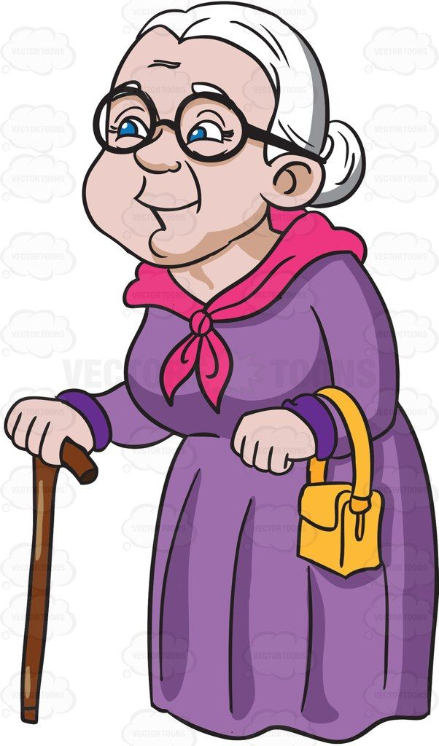
Antonyms – Fill in the blanks
Her grandmother is _______ but the baby is ________.

Slide 20
Antonyms – Fill in the blanks
Her grandmother is old but the baby is young.

Slide 21
Antonyms – Fill in the blanks
Mia was ______ in TESOL class but Mark was _______. Therefore, Mia received 100% grade for participation but Mark received 0%.

Slide 22
Antonyms – Fill in the blanks
Mia was present in TESOL class but Mark was absent. Therefore, Mia received 100% grade for participation but Mark received 0%.

Slide 23
What is the antonym for the underlined word?
The day was cold and dark.

Slide 24
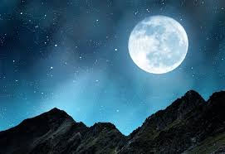
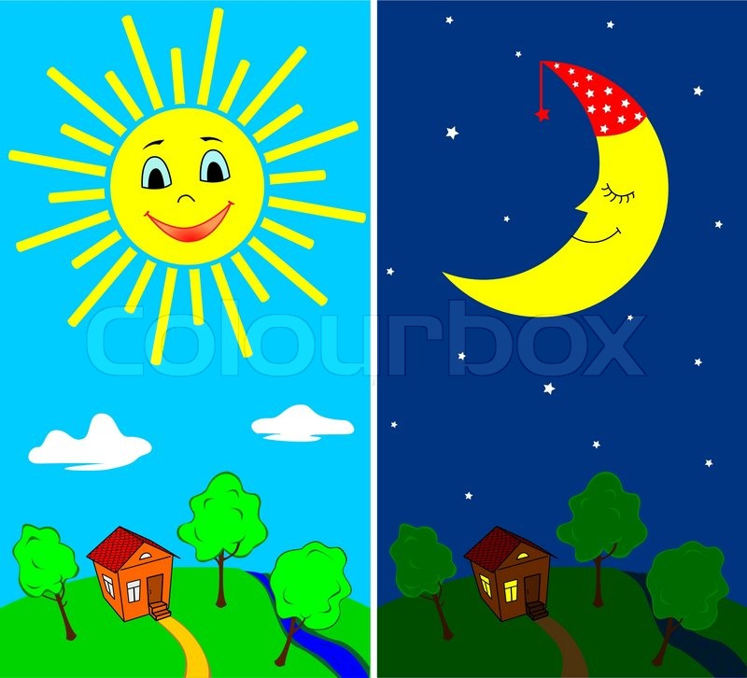
Answer
night

Slide 25
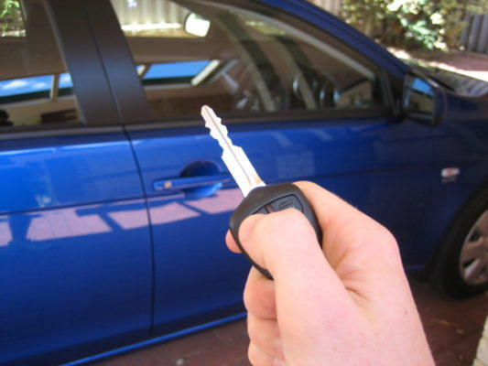
What is the antonym for the underlined word?
Jayme bought a new car this weekend.

Slide 26
Answer
Sold

Slide 27
What is the antonym for the underlined word?
He is an optimist because he is hopeful about the future.

Slide 28
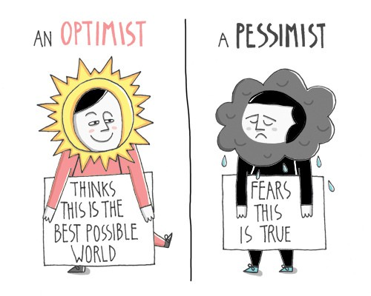
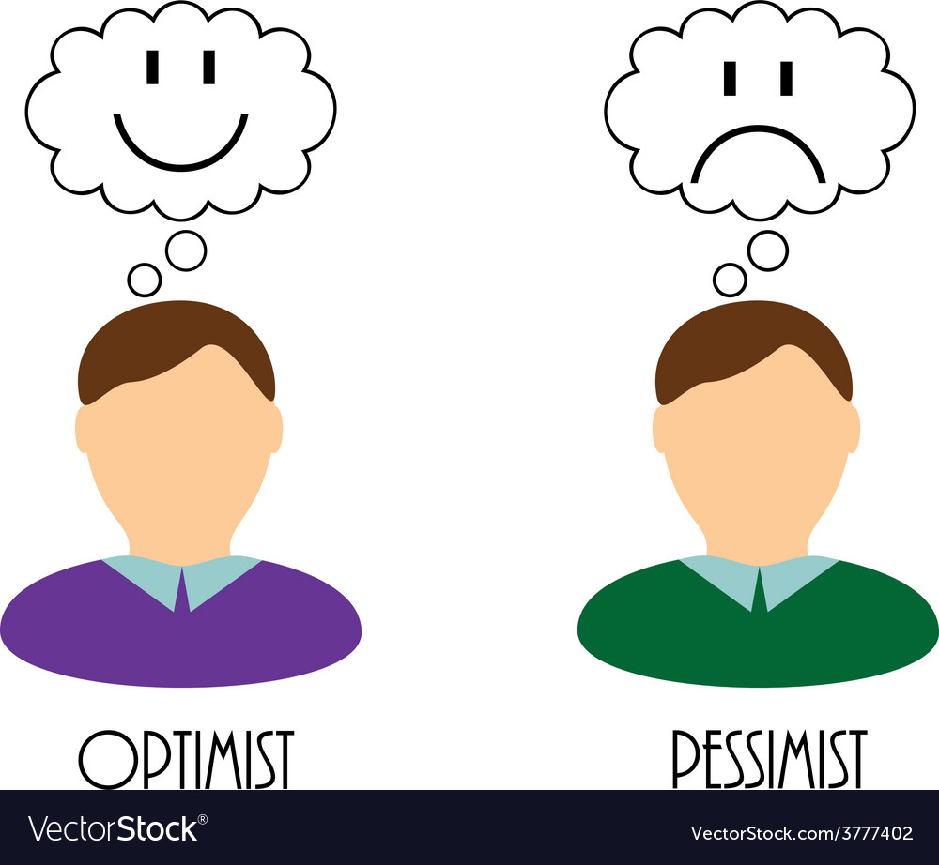
Answer
Pessimist

Slide 29
Find Two Antonyms
woman, child, kid, adult

Slide 30
Answer
woman, child, kid, adult

Slide 31
Find Two Antonyms
guest, VIP, host, customer

Slide 32
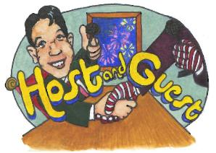
Answer
guest, VIP, host, customer

Slide 33
Review of Antonyms
Happy <-> Sad
Sit <-> Stand
Big <-> Small
Hot <-> Cold
Sweet <-> Bitter
Fast <-> Slow
Old <-> Young
Present <-> Absent
Day <-> Night
Bought <-> Sold
Optimist <-> Pessimist
Child <-> Adult
Guest <-> Host

