Slide 1
Viva La Vida
Lydia Kang

Slide 2
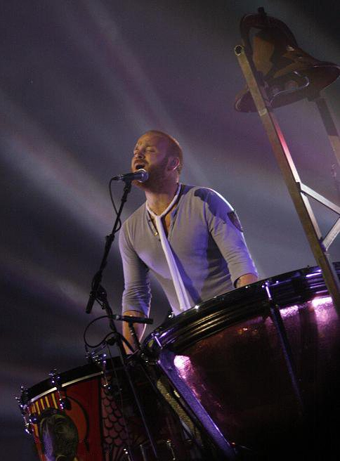
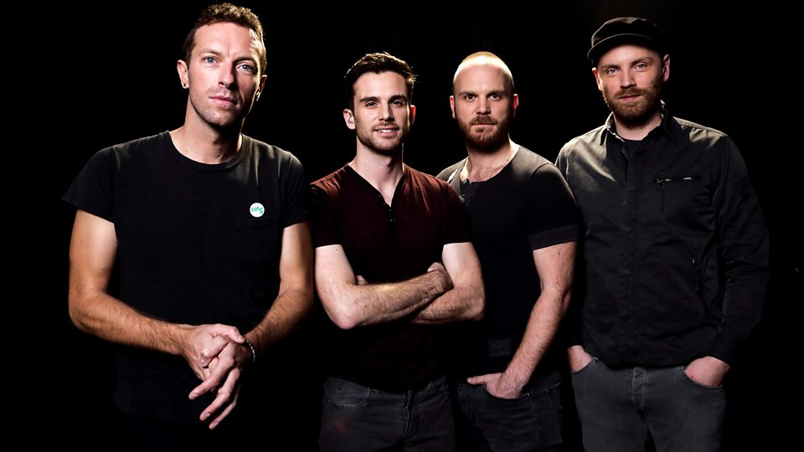
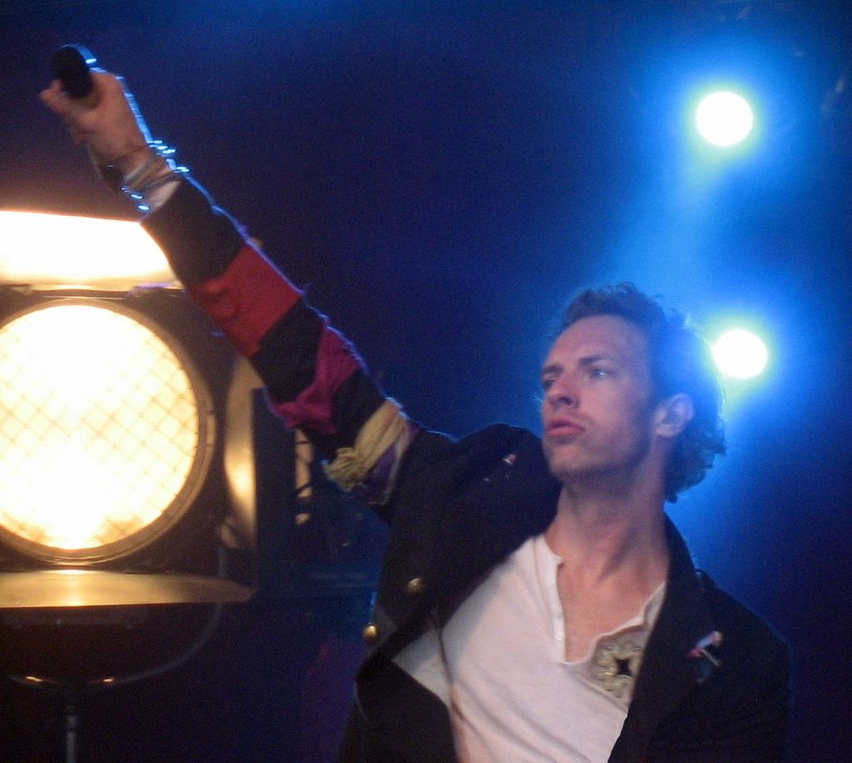
Guess Who?

Slide 3
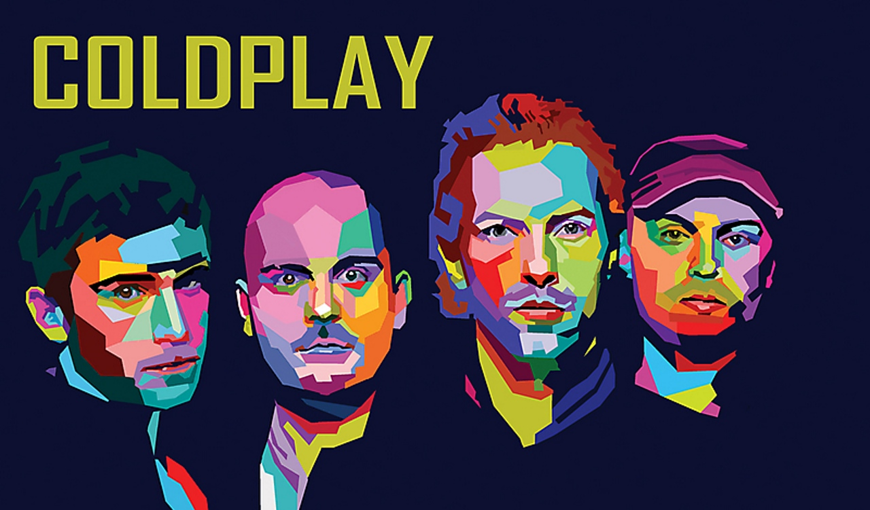

Slide 4
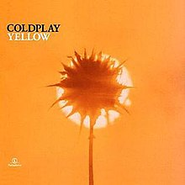
Coldplay Greatest Hits
Clocks
The Scientist
Yellow
Fix You
Paradise
Hymn For The Weekend
Trouble
Magic
Adventure of a Lifetime
A Sky Full of Stars

Slide 5
Vocabulary

Slide 6
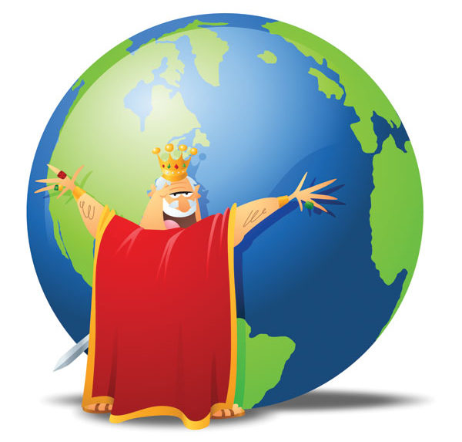
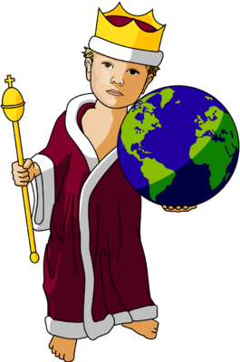
Rule the World
Hitler wanted to rule the world by being an evil dictator.

Slide 7
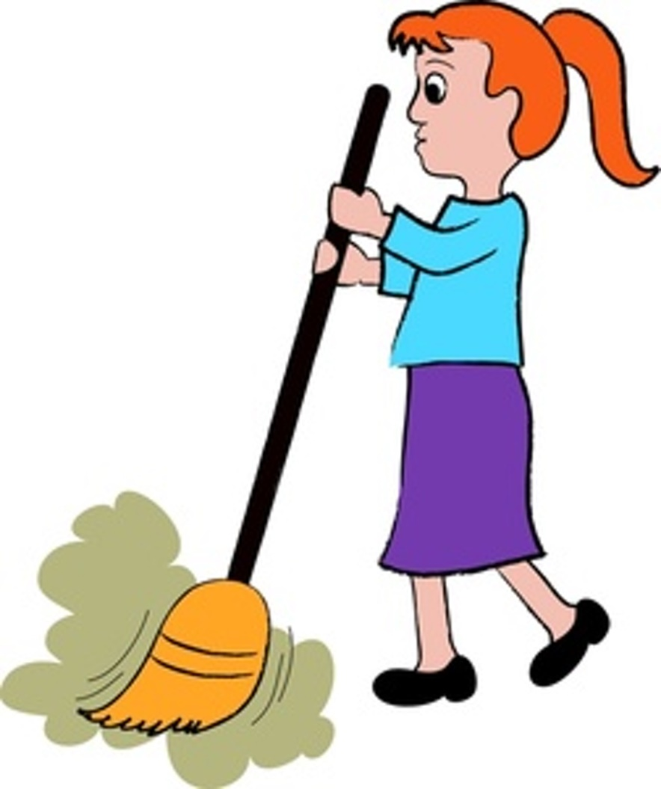
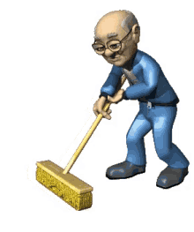
Sweep
She sweeps the streets everyday because the streets are full of dust.

Slide 8
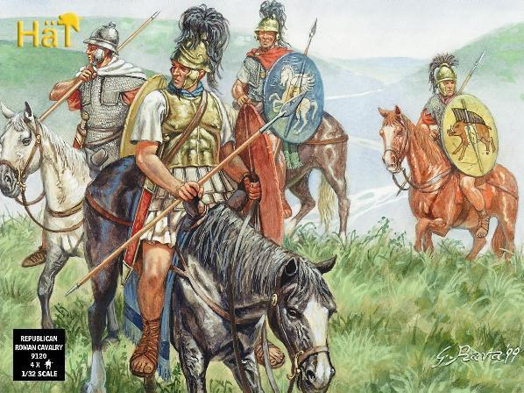
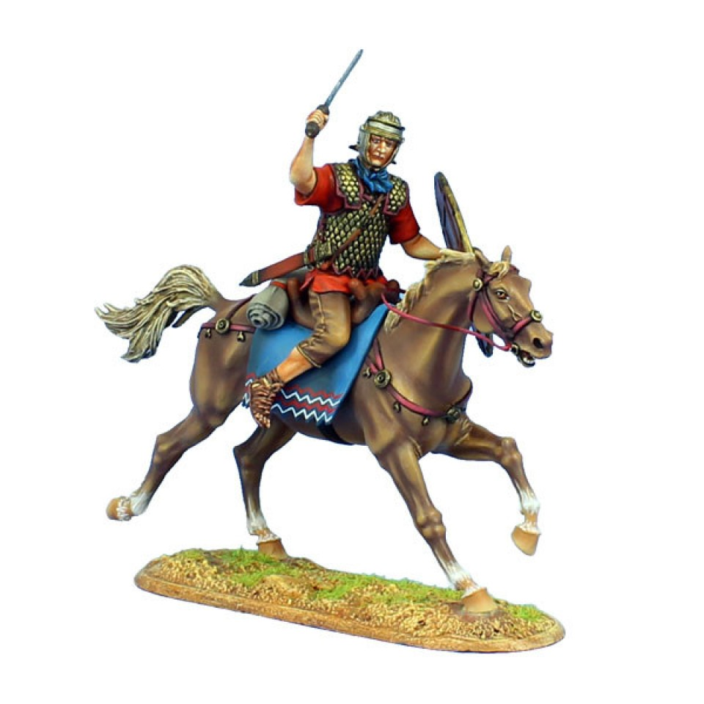
Roman Cavalry
Roman cavalry refers to the horse-mounted forces of the Roman army throughout the Regal, Republican, and Imperial eras.

Slide 9
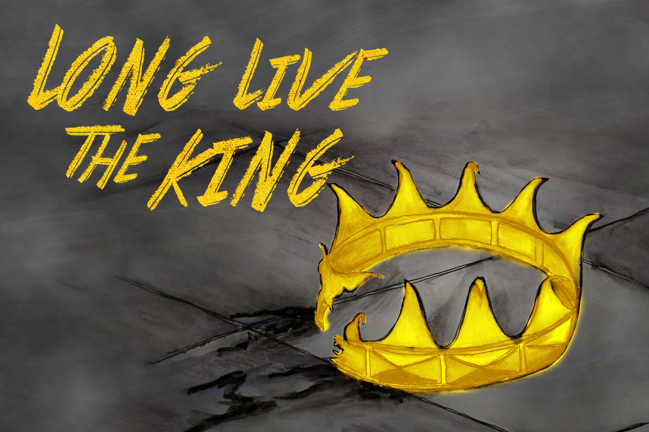
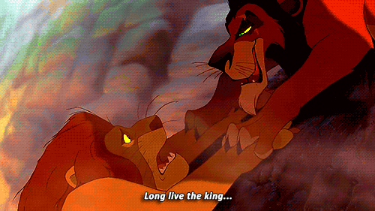
Long Live The King
"Long live the King!" refers to the heir who immediately succeeds to a throne upon the death of the preceding monarch. Meaning the monarchy never dies even when the King does.

Slide 10
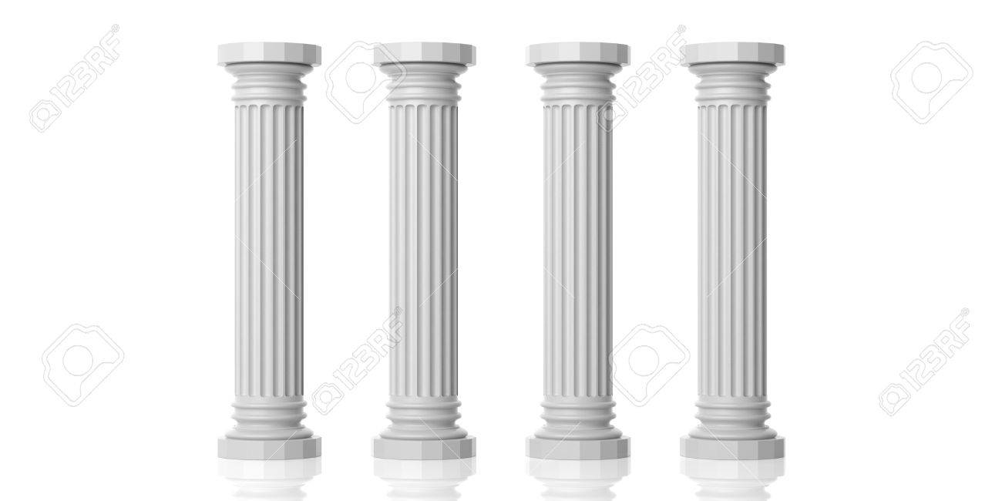
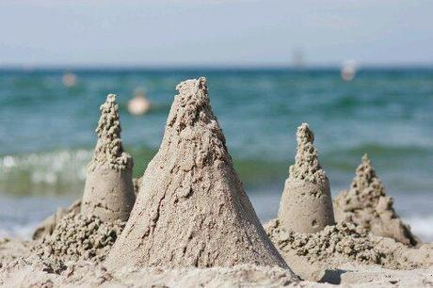
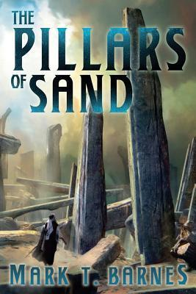
Pillars
The children built the pillars of sand on the beach.

Slide 11
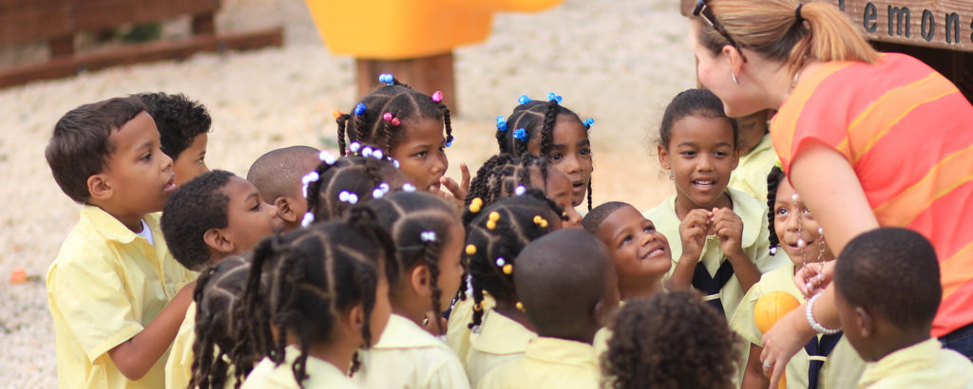
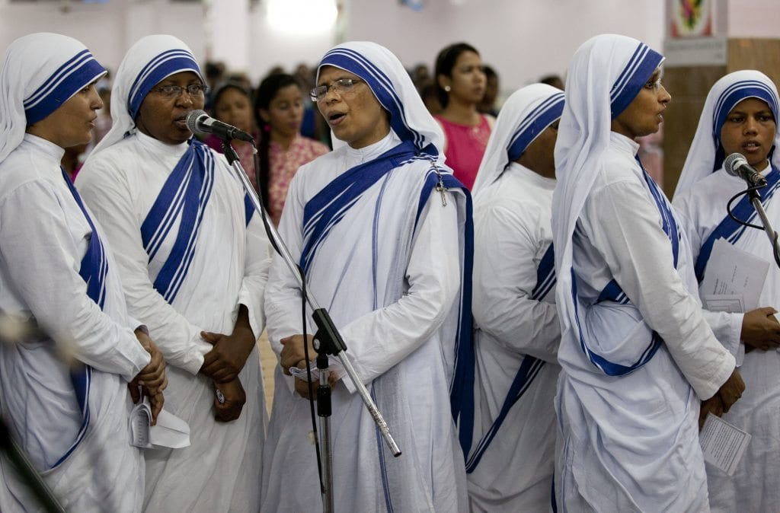
Missionaries
The missionaries were in Africa to help the hungry children.

Slide 12
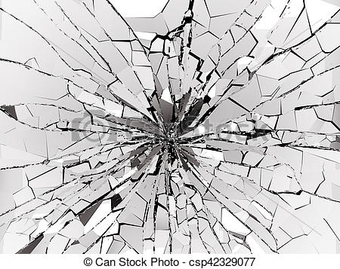
Shattered
The glass was shattered into small pieces.

Slide 13
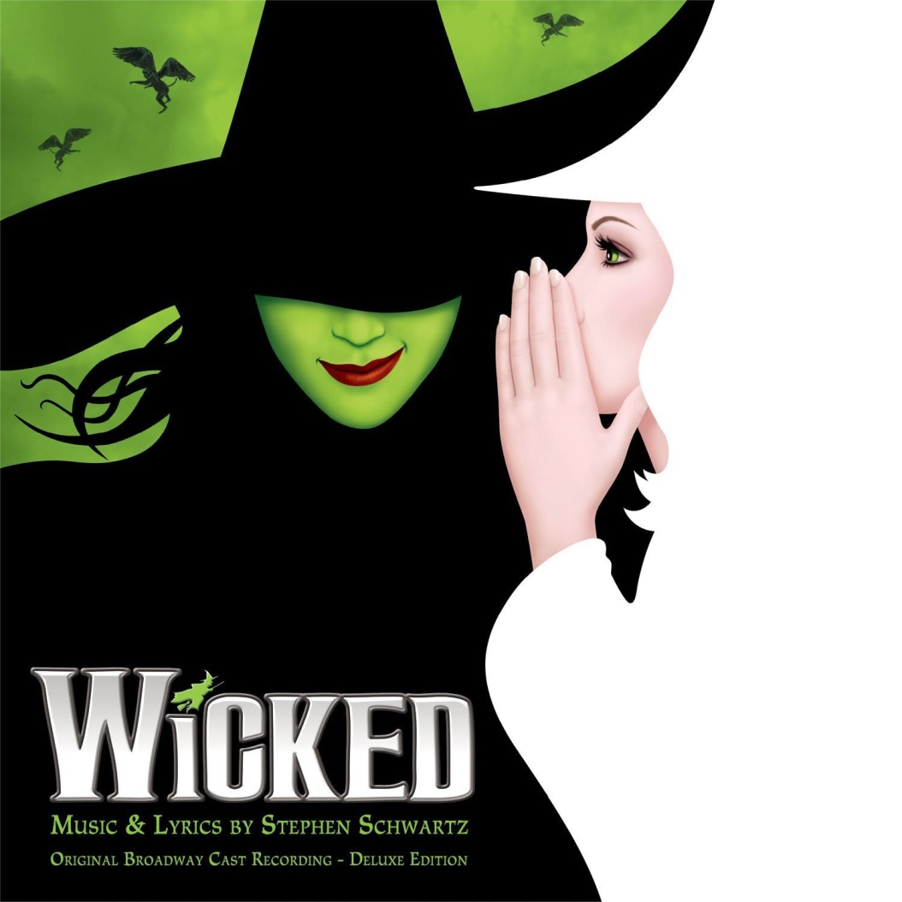
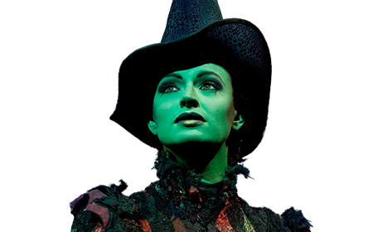
Wicked
She was wicked for she was a witch.

Slide 14
Protagonist
protagonist
The protagonist of the book is Sherlock Holmes because he is the major character.

Slide 15
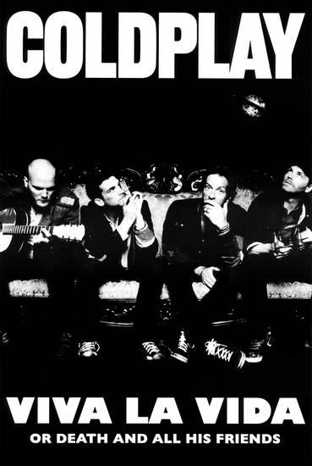
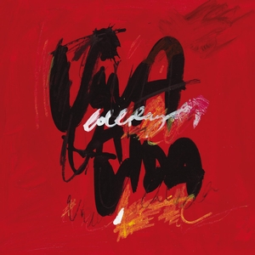
Viva La Vida

Slide 16
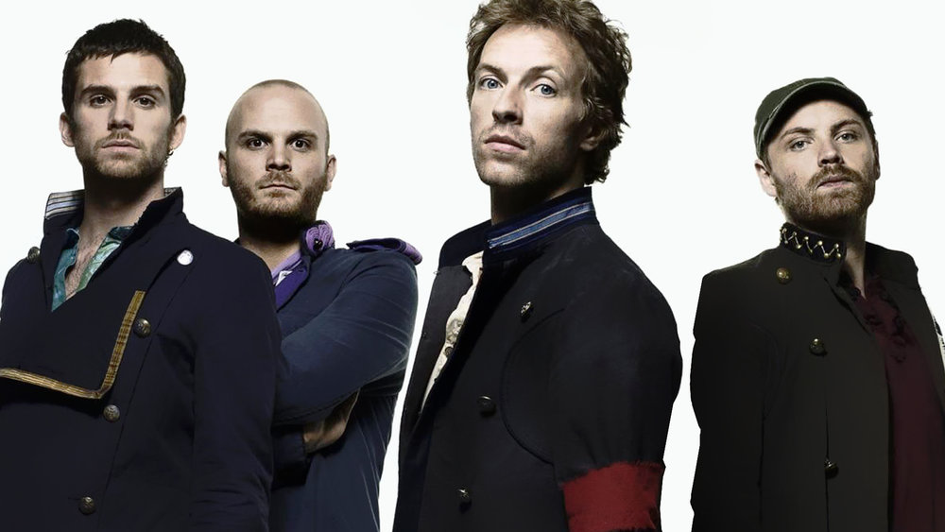
Viva La Vida Game
Q: What nationality is the band Coldplay?

Slide 17
Viva La Vida Game
A: British

Slide 18
Viva La Vida Game
Q: Which Album was Viva La Vida on?

Slide 19
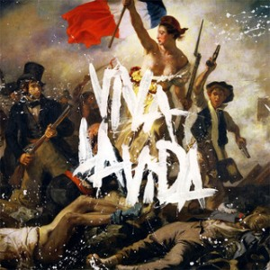
Viva La Vida Game
A: Fourth album, Viva la Vida or Death and All His Friends (2008)

Slide 20
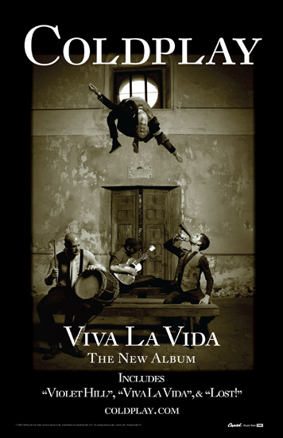
Viva La Vida Game
Q: What does Viva La Vida mean in Spanish?

Slide 21
Viva La Vida Game
A:"Long Live Life" or simply "Live Life".

Slide 22
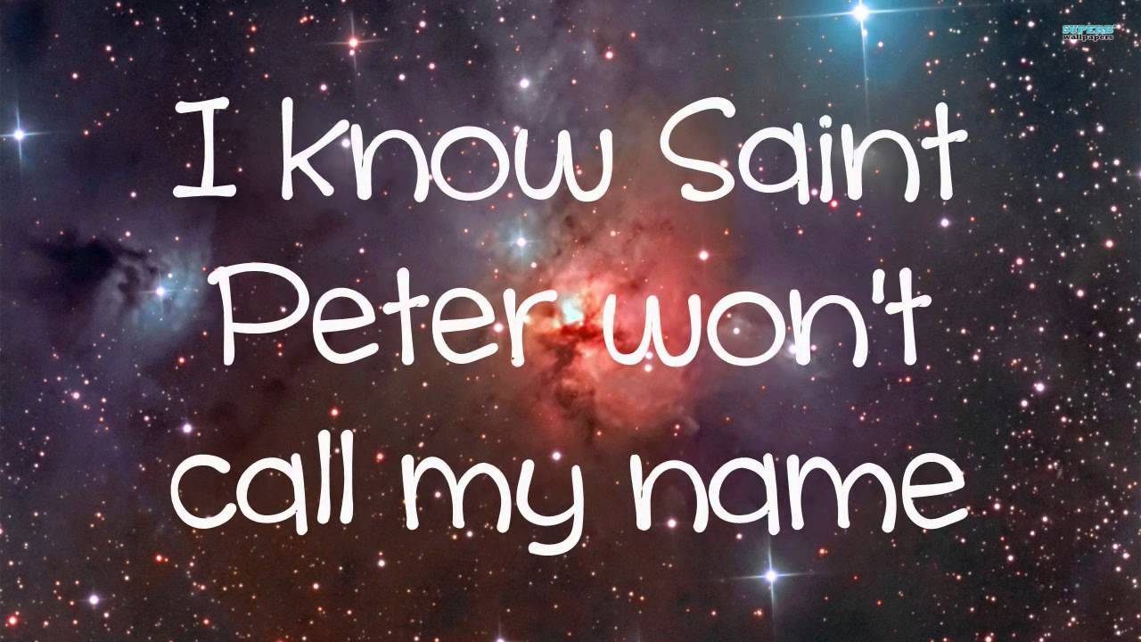
Viva La Vida Game
Q: What kind of reference does the lyric to the song contain?

Slide 23
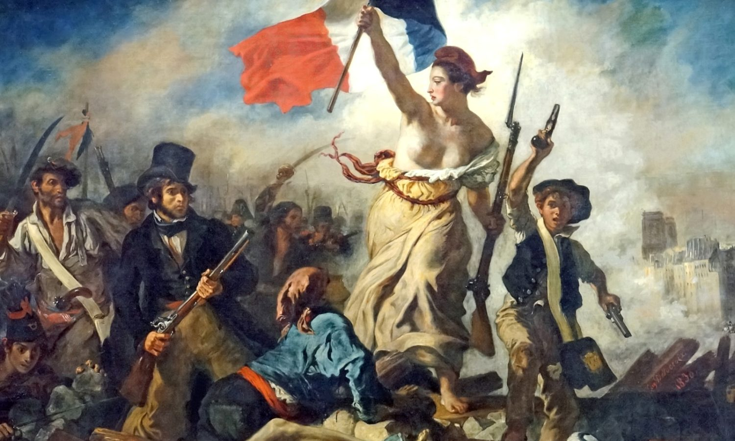
Viva La Vida Game
A: Historical and Christian references

Slide 24
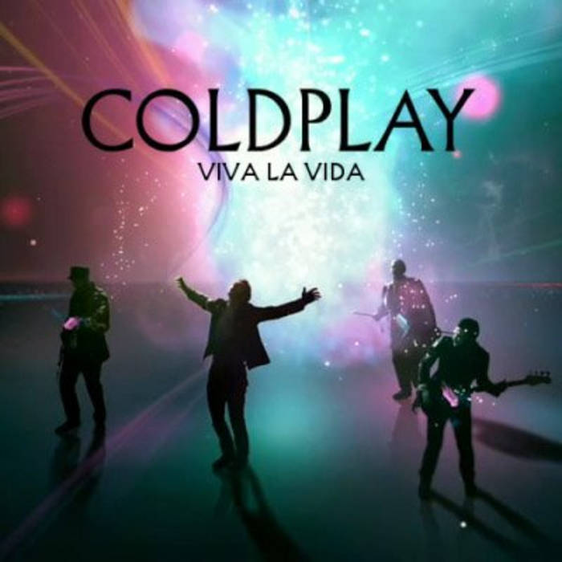
Viva La Vida Game
Q:When was the song released?

Slide 25
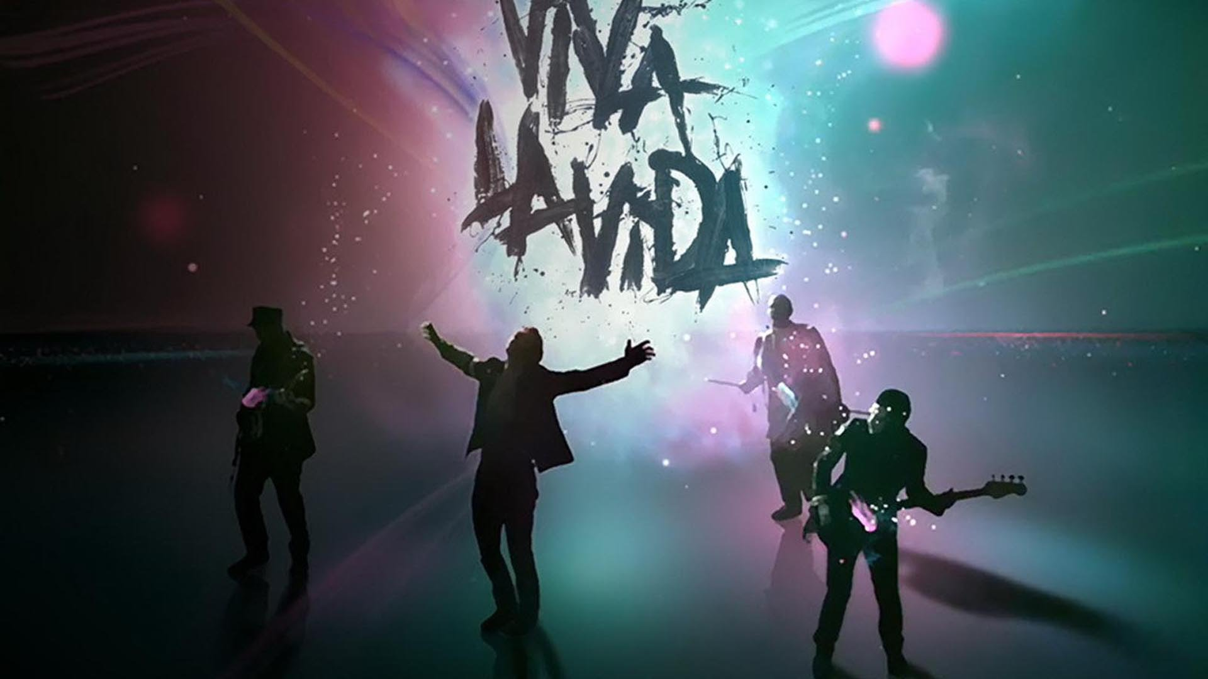
Viva La Vida Game
A: 13 June 2008

Slide 26
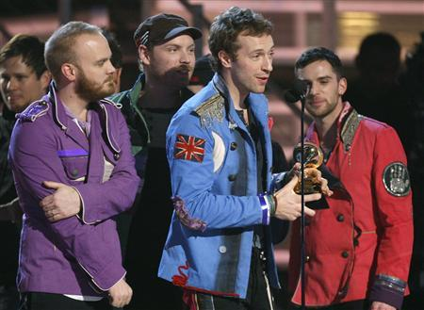
Viva La Vida Game
Q:What kind of award did the song win?

Slide 27
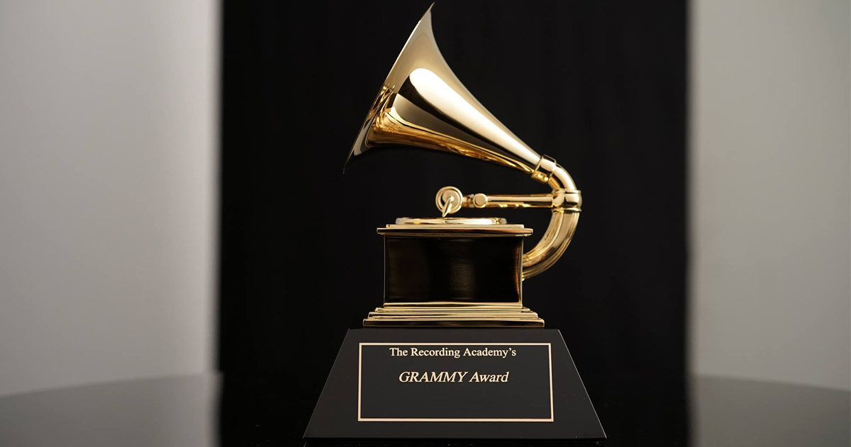
Viva La Vida Game
A:Grammy Award

Slide 28
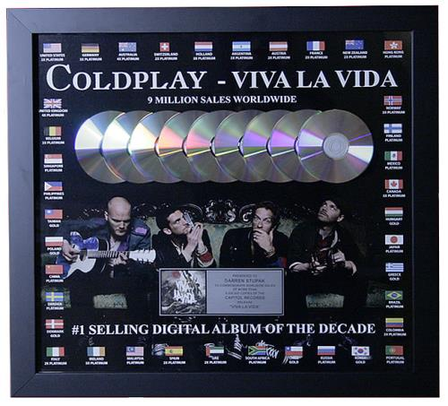
Viva La Vida Game
Q: How many copies did the song sell worldwide by 2014?

Slide 29
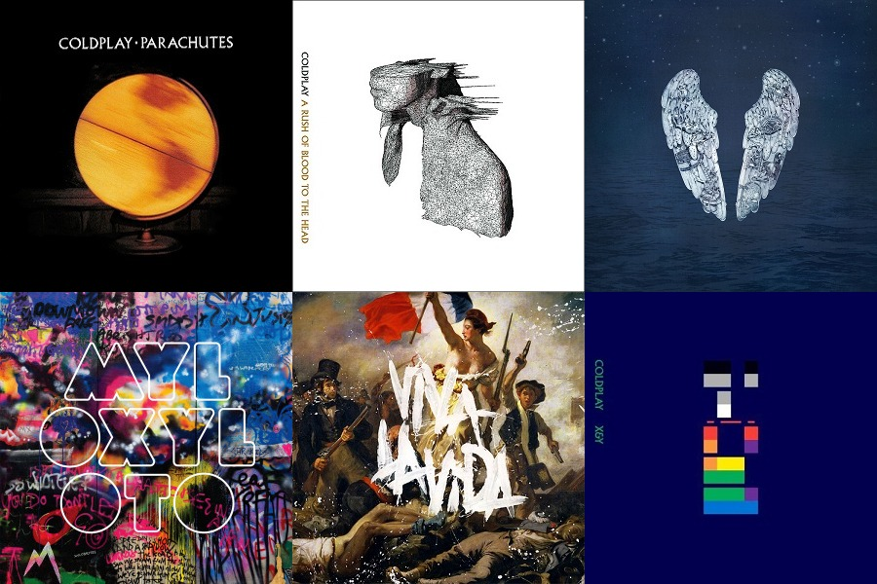
Viva La Vida Game
A: 7.1 million copies worldwide by 2014

Slide 30
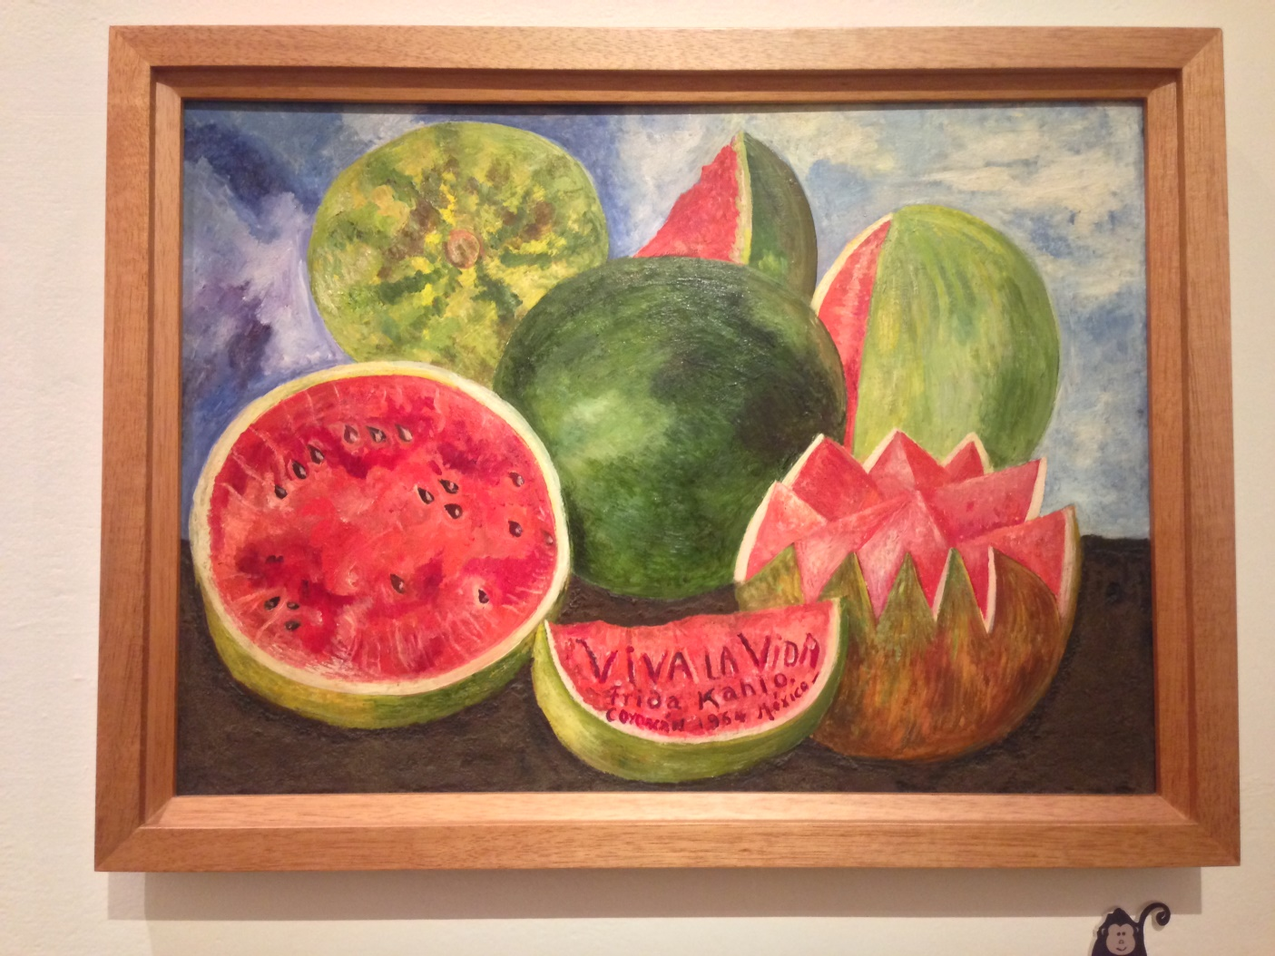
Viva La Vida Game
Q: Who is the artist that the “Viva la Vida” painting is from?

Slide 31
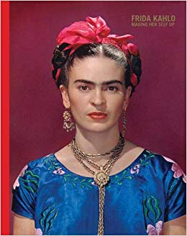
Viva La Vida Game
A: 20th-century Mexican artist Frida Kahlo.

Slide 32
Viva La Vida Game
Q: What does the protagonist say?

Slide 33
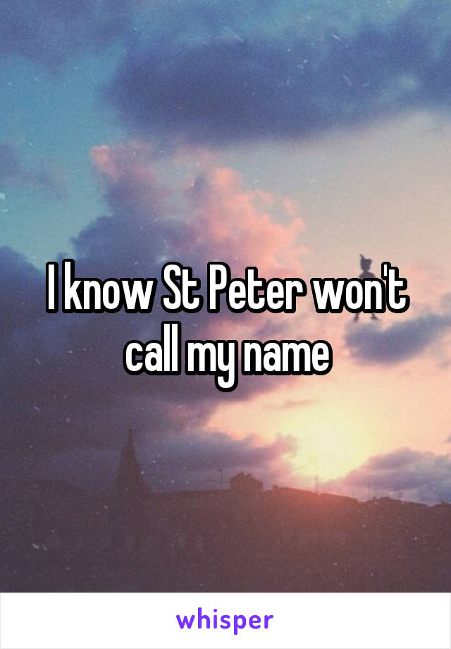
Viva La Vida Game
A: I know Saint Peter won't call my name

Slide 34
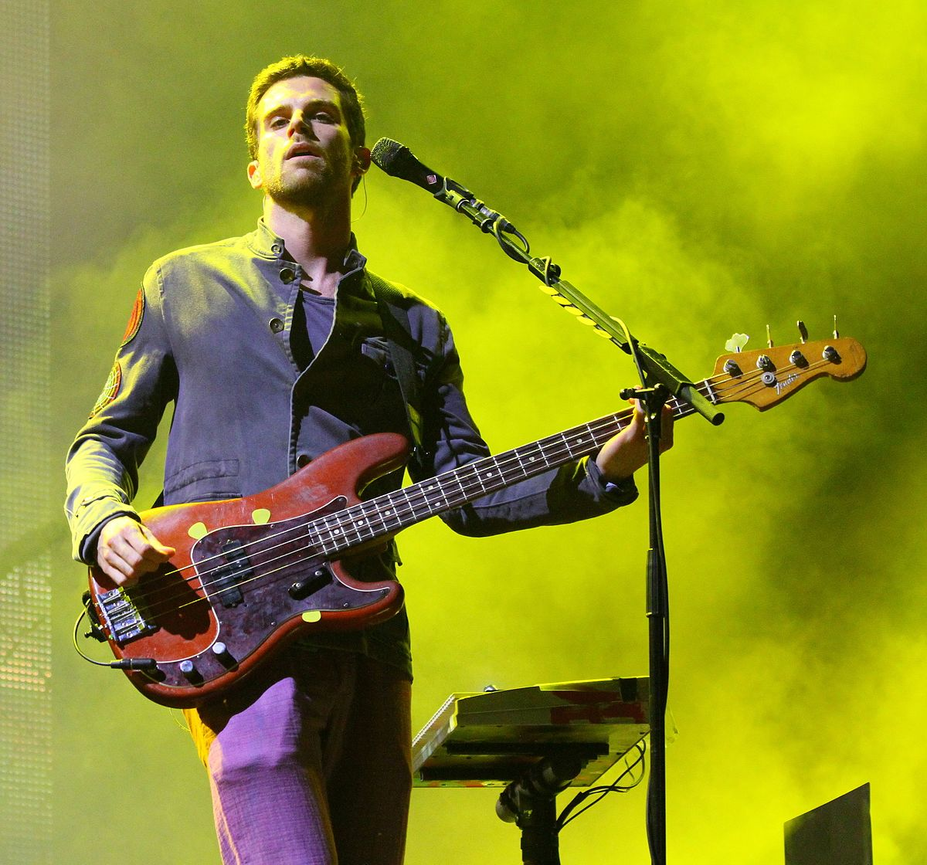
Viva La Vida Game
Q: According to the bass guitarist Guy Berryman , what is the song about?

Slide 35
Viva La Vida Game
A: It's a story about a king who's lost his kingdom

Slide 36
Vocabulary List
Rule the world,
Sweep
Roman Cavalry
Long live the king
Pillars
Missionaries
Shattered
Wicked
Revolutionaries
Protagonist

