Slide 1
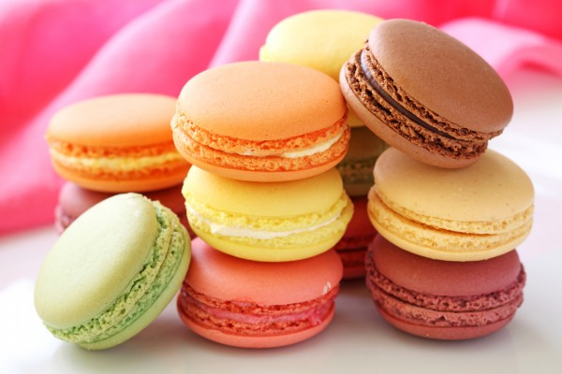
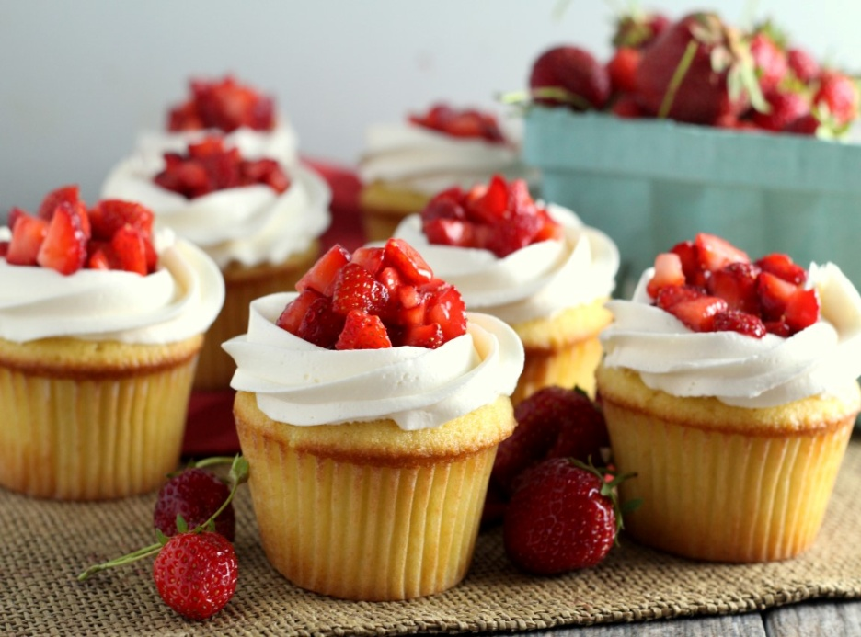
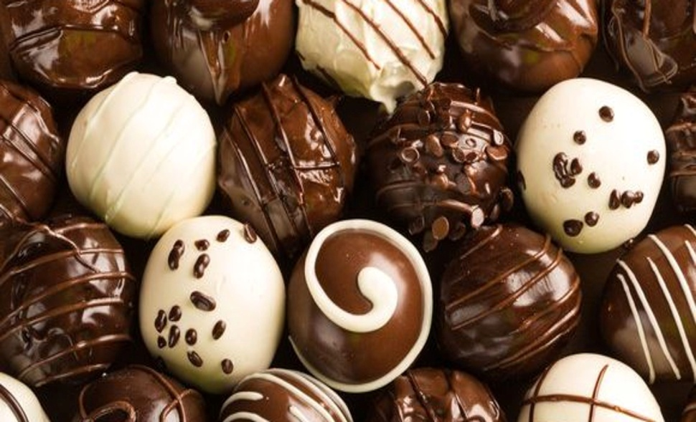
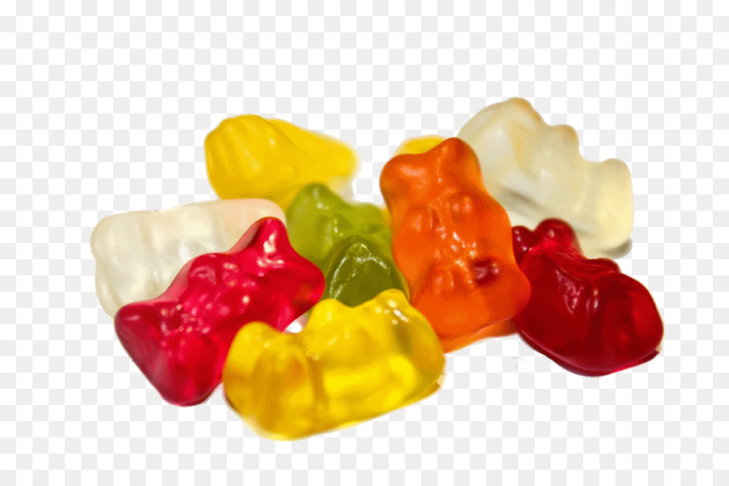

Slide 2
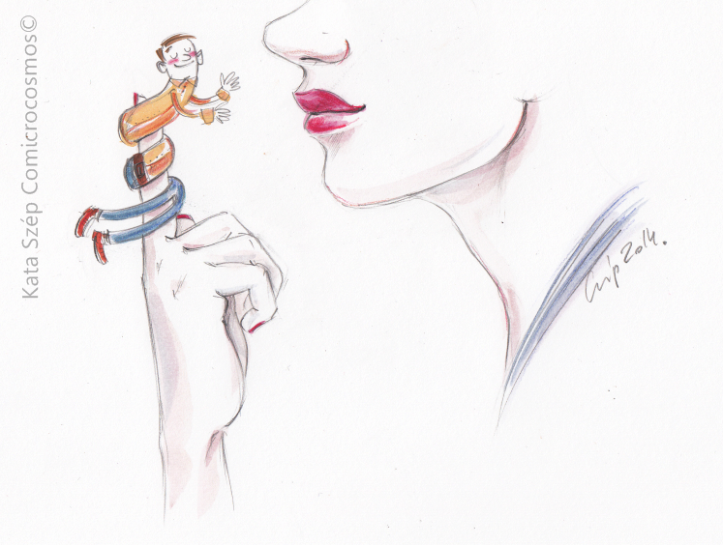
She had him wrap around her little finger.

Slide 3
stupid silly
smart clever
↕
dim-witted
He was such a dim-witted boy.
adjective
Is he mentally bright?
(No)

Slide 4
Do you have any experience in winning an event unexpectedly? (e.g. free gift, tickets, money, toys, anything..)

Slide 6
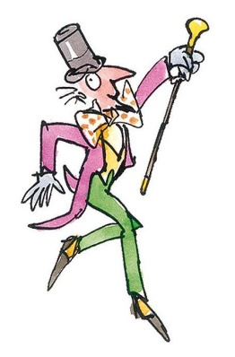
Create your own sweet !!
It may have special power to do something !
e.g. hot ice-cream for cold days
losing weight chocolate
an everlasting candy

