Slide 1
Have you heard “Smombie”?

Slide 2
Smartphone
+ Zombie
=> Smombie

Slide 3
inattentional
deafness
in at ten tion al
deaf ness

Slide 4
[ True or False Quiz ]
1. We aren’t able to hear when we are focusing on visual task.
<True>
2. Researchers at the University College London tested only
their ability of auditory without brain process.
<False>
3. The participants of this research are originally deaf.
<False>
4. The researchers explain inattentional deafness is not
related with the brain process.
<False>

Slide 5
Many people think that multi-tasking helps get things done more quickly.
But do you think that the multi-tasking is effective after reading this article?
Why or why not?

Slide 6
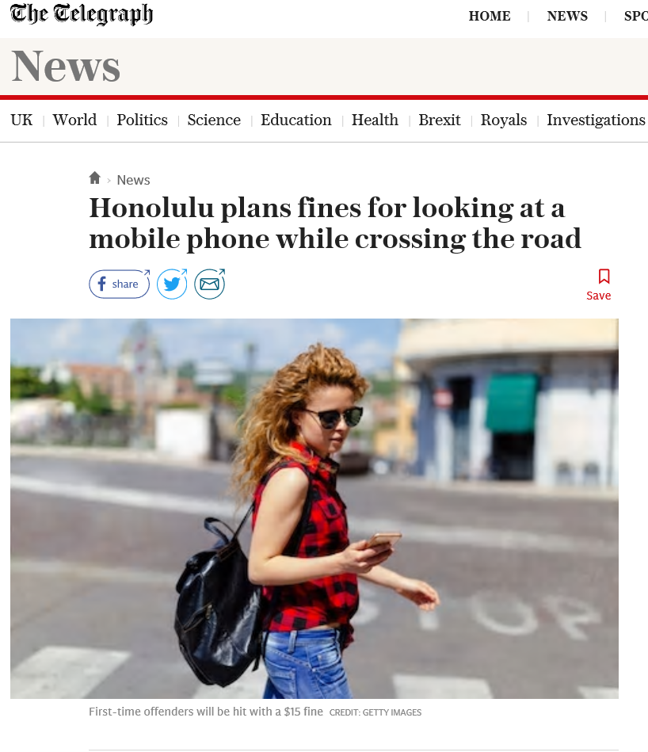
In Hawaii, Honolulu, pedestrians who look at their mobile phones while crossing the road face fines of up to $99.
Is it reasonable or not?

