Slide 1
Speaking Lesson
Jiyang Kim

Slide 2
Slide A:
Describe what this is.

Slide 3
Let’s take a step back!

Slide 4
Slide B:
Describe what this is.

Slide 5
Let’s take another step back!

Slide 6
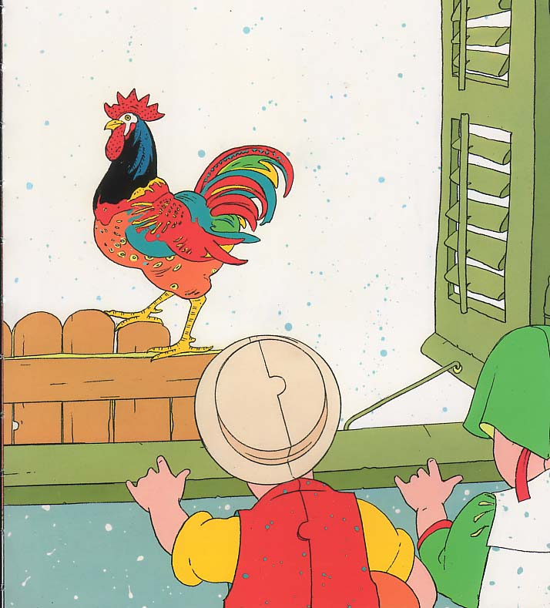
Slide C:
Describe what this is.

Slide 7
Question
Is seeing a big picture important? Why?
Talk to your friends

Slide 8
Rules
Do not show your pictures to others!
Take a turn to answer questions every 2 min
One student gets questions from two students at a time.
Ex.) ⓵ Ina and Jessica ask Hailey questions about pictures.
⓶ Jessica and Hailey ask Ina questions.
⓷ Hailey and Ina ask Jessica questions.

