Slide 1
Good morning !

Slide 2
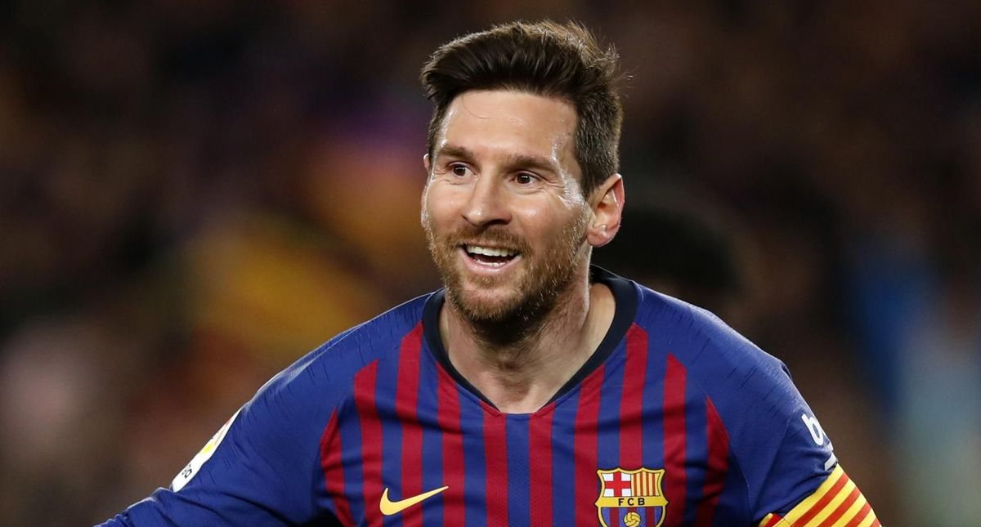
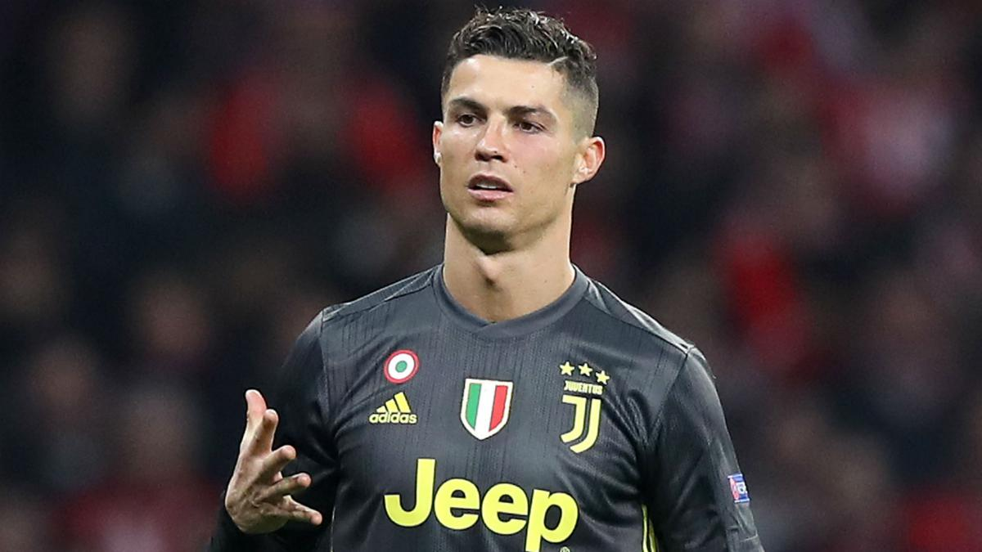
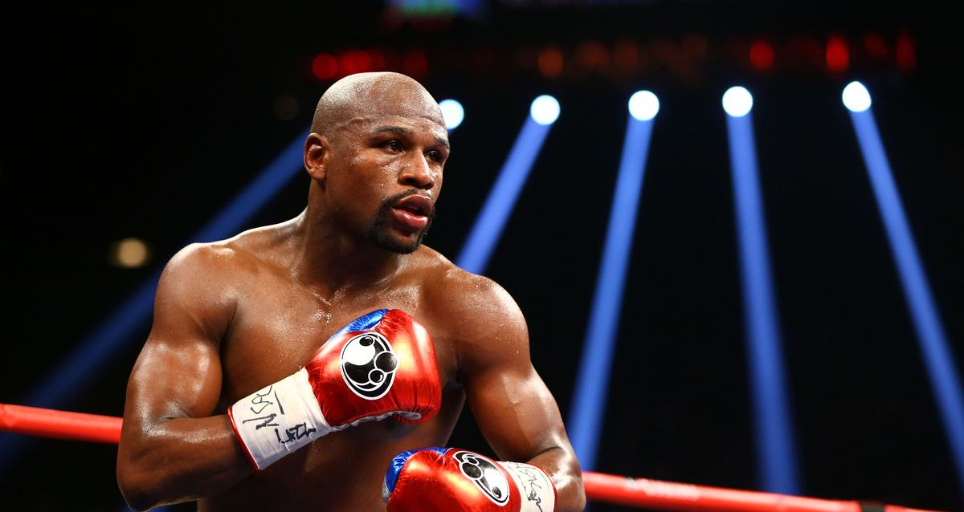
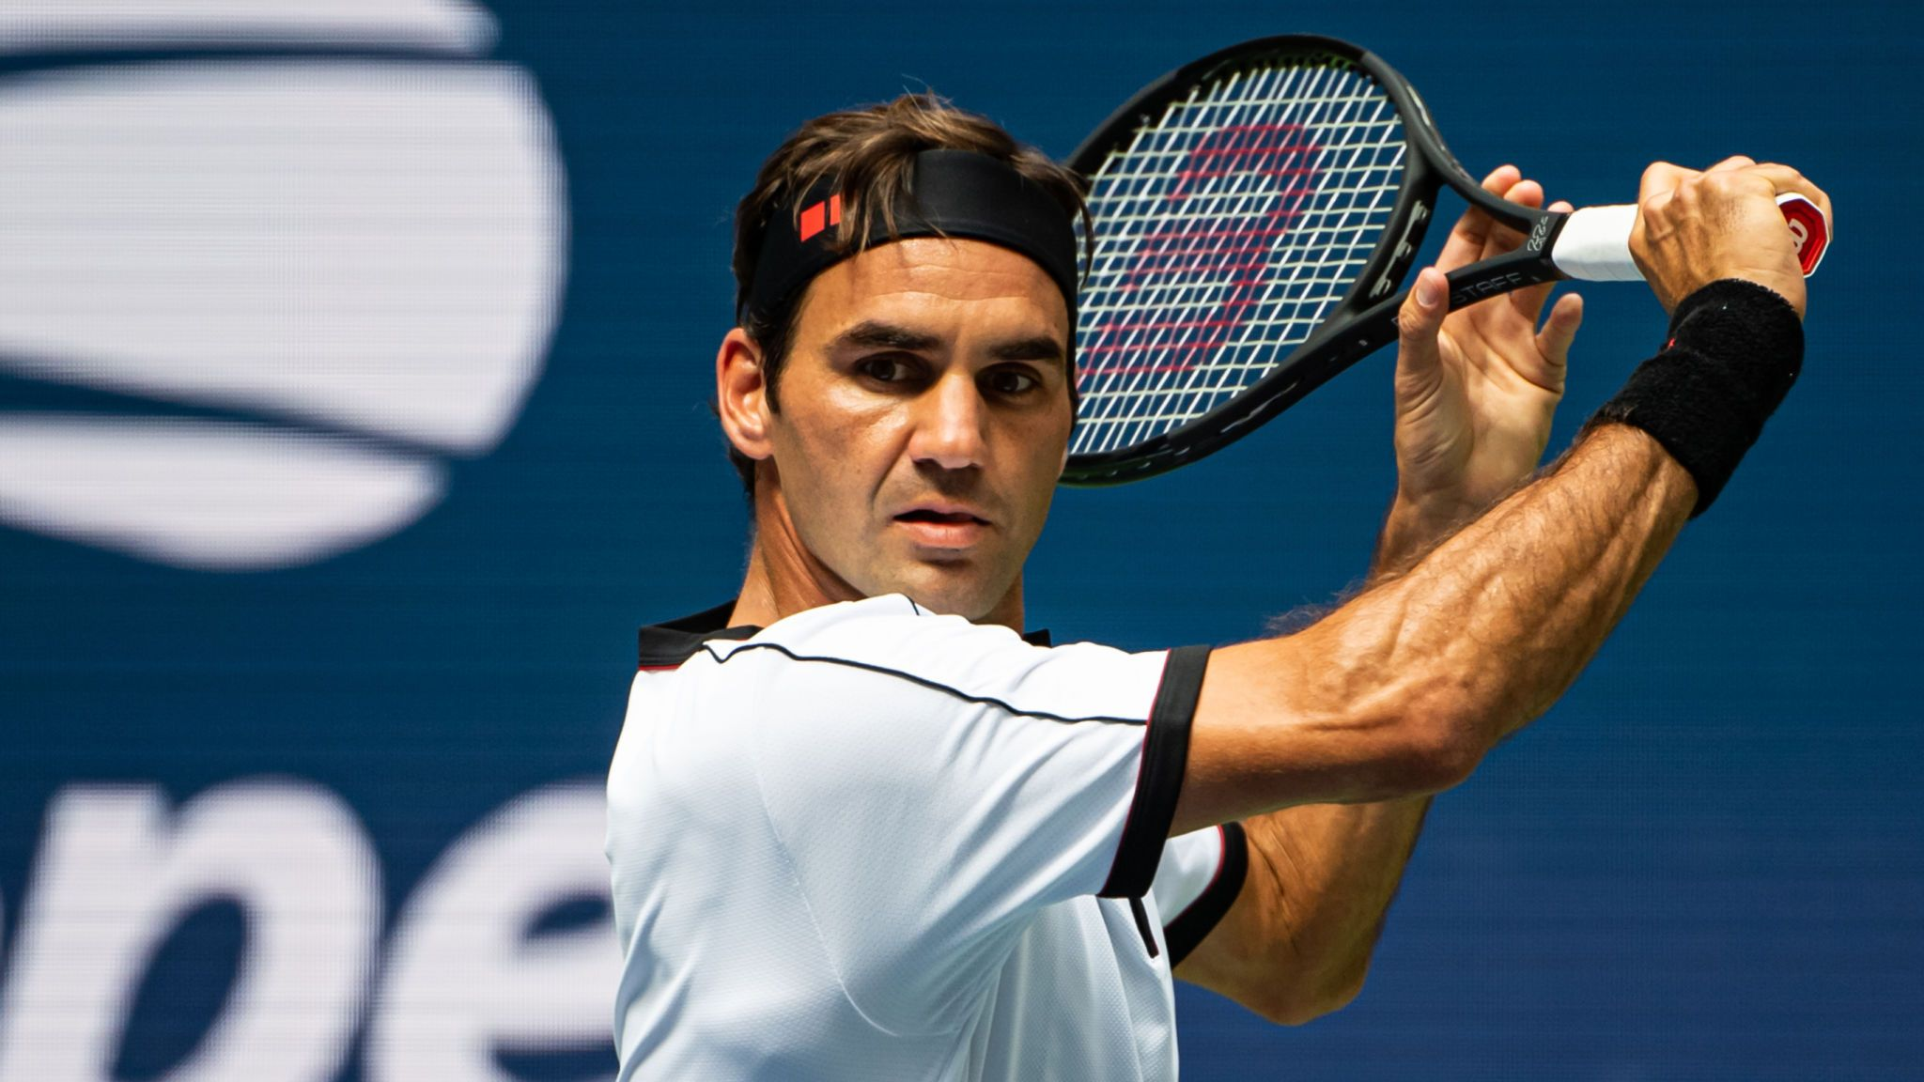
Lionel Messi
Christiano
Ronaldo
Floyd Mayweather
Roger Federer

Slide 3
$285 million
$127 million
$109 million
$93.4 million
Notes:
Do you think they deserve that salary? Talk with your partner.

Slide 4
$127 million a year

