Slide 1
Is there best time to call your date after a first date?
When is it?

Slide 2
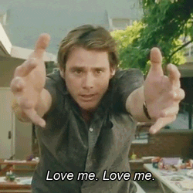

Slide 3
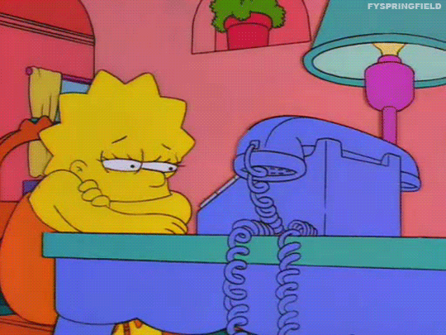

Slide 4
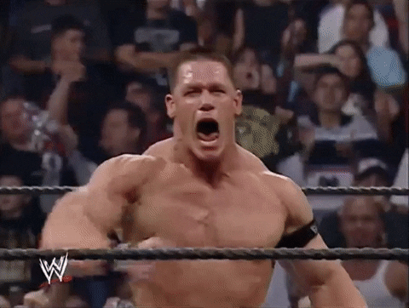

Slide 5
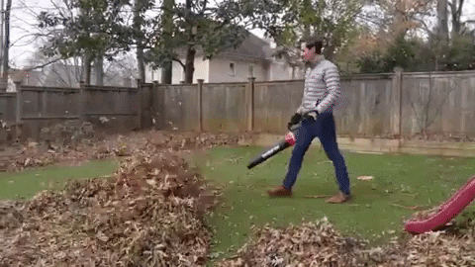

Slide 6
How would you contact your date after a first date?
What would you say to ask for a second date?

